Slide 1
Future changes in severe thunderstorm environments in Europe
Tomáš Púčik Pieter Groenemeijer
Lars Tijssen
Anja T. Rädler
The ARCS project is supported by the German Ministry of Education and Research as part of its programme on sustainable development: www.fona.de
The ARCS project is supported by Munich RE.
The contents of this presentation are the author's views. The EU is not liable for any use that may be made of the contained information.

Slide 2
Research questions
Q1: Will the favourable environments for severe thunderstorms in Europe increase or decrease in the future? Why?
Q2: How big is the uncertainty in the models?

Slide 3
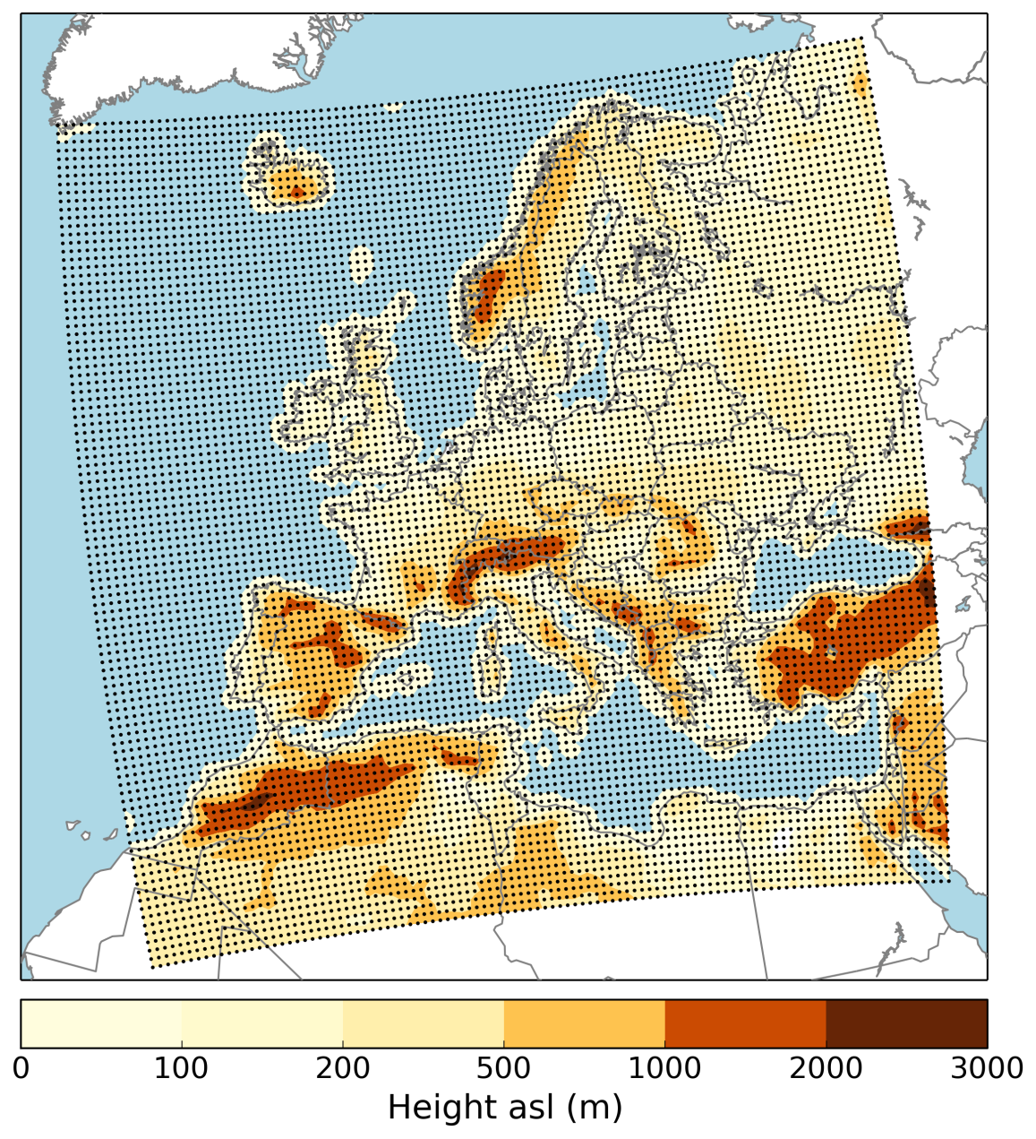
Dataset
14 EURO-CORDEX model ensemble:
5 regional models
10 CMIP5 models
RCP4.5 and RCP8.5 scenarios
0.44 ° resolution
6h-ly data
Centre | RCM | GCM
KNMI | RACMO22E | EC-EARTH
 |  | HadGEM2-ES
SMHI | RCA4 | CanESM2
 |  | CNRM-CM5
 |  | CSIRO-Mk-3-6-0
 |  | EC-EARTH
 |  | GFDL-ESM2M
 |  | IPSL-CM5A-MR
 |  | MIROC5
 |  | MPI-ESM-LR
 |  | NorESM1-M
MPI-CSC | REMO2009 | MPI-ESM-LR
CLMCOM | CCLM4 | HadGEM2-ES
NUIM | WRF341 | EC-EARTH

Slide 4
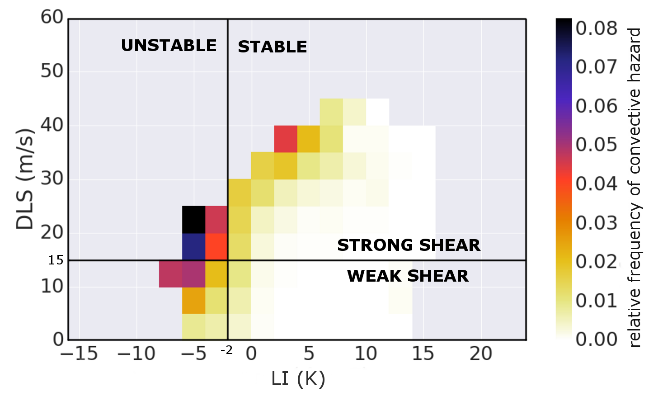
Severe thunderstorm environments
Highest probability of
severe:
Unstable
(LI <= -2 K)
Strongly sheared
(DLS >= 15 m/s)
Initiation?:
Precipitating
(precip >= 1 mm/6h)
Lifted Index (LI)
minimum value from 925, 850 and 700 hPa
Deep layer shear (DLS)
10 m – 500 hPa bulk wind shear

Slide 5
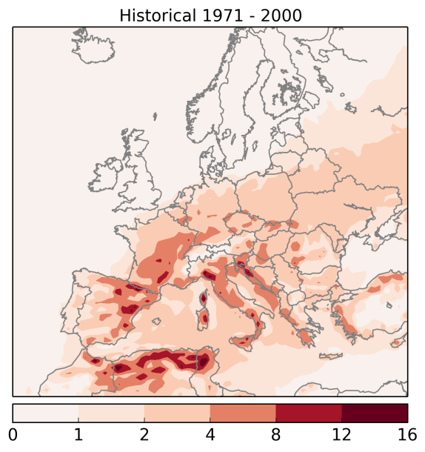
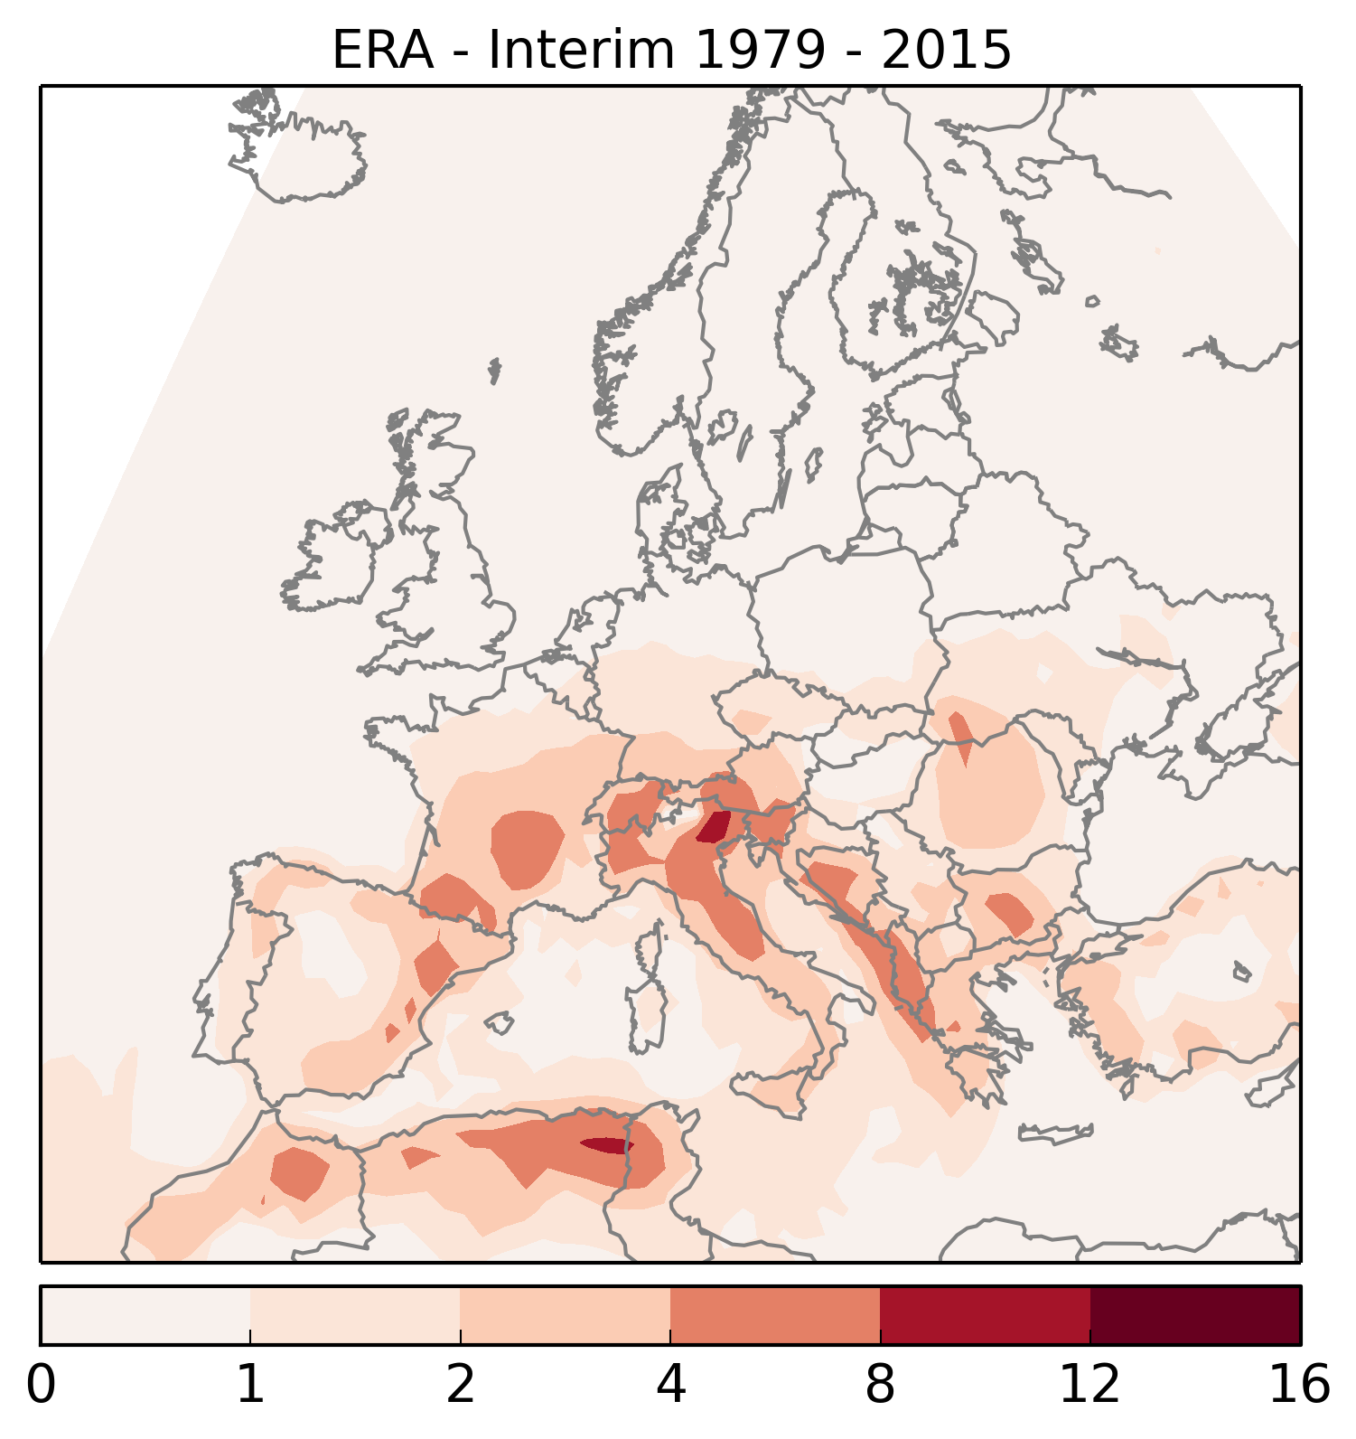
Severe - present
severe environment:
unstable
strongly sheared
precipitating
LI <= -2
DLS >= 15
Precip >= 1
EURO-CORDEX 1971 - 2000
ERA-INTERIM 1979 - 2015
Large scale patterns
are similar
EURO-CORDEX with
positive bias
vs
annual number of 6-hourly periods

Slide 6
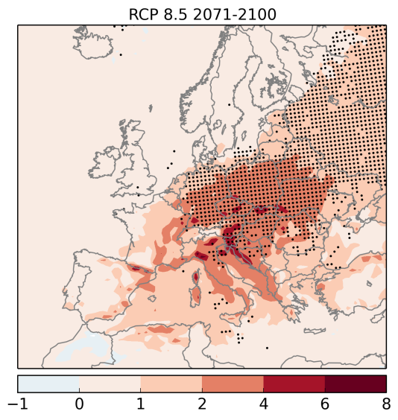
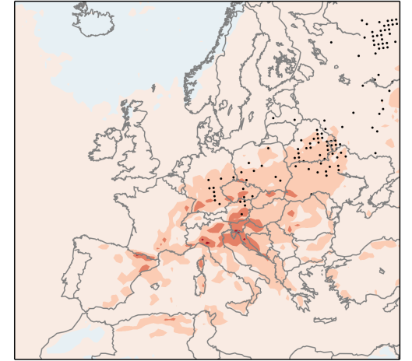
Severe - future
change until 2071-2100
RCP 8.5
severe environment:
unstable
strongly sheared
precipitating
robust increases
of up to 100 %
LI <= -2
Black dots:
Mean change
>
2 x
standard
deviation
DLS >= 15
Precip >= 1
increases not robust here
1971-2000
RCP 4.5
increases up to 50 % &
less robust
annual number of 6-hourly periods

Slide 7
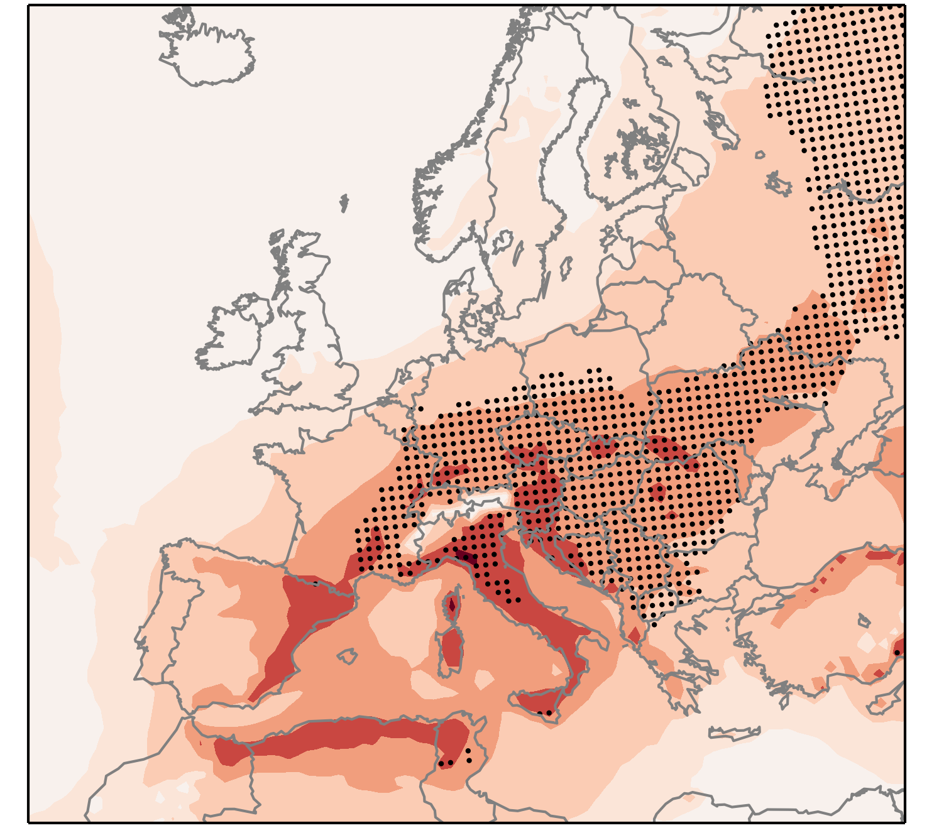
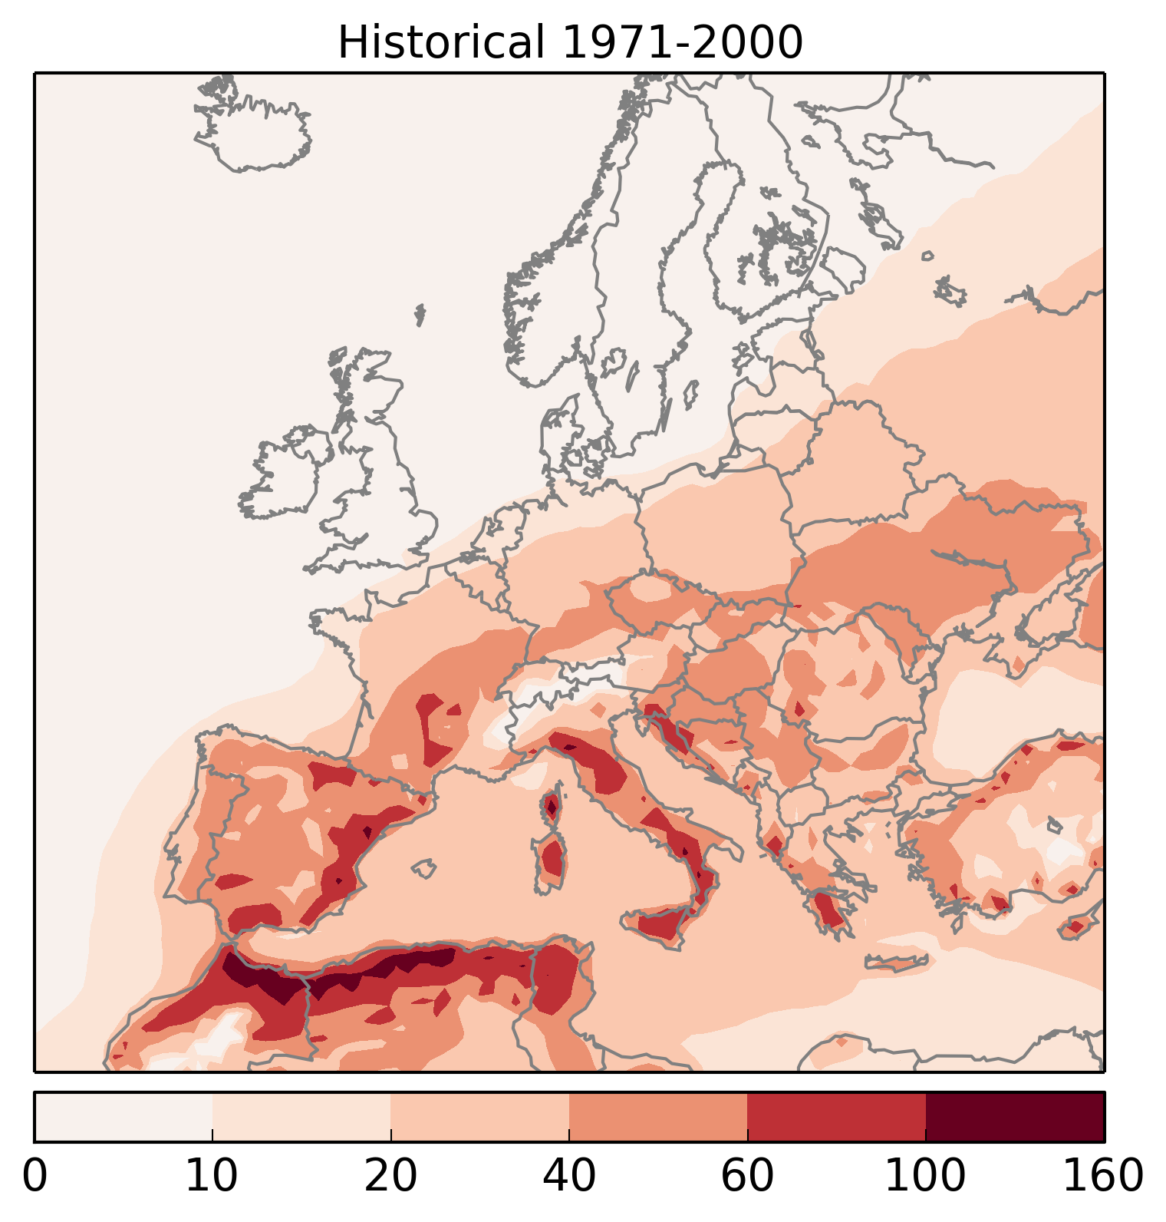
Instability
change until 2071-2100
RCP 8.5
severe environment:
unstable
strongly sheared
precipitating
robust increases
of up to 100 %
LI <= -2
increases not robust here
1971-2000
RCP 4.5
increases around 25% &
less robust
annual number of 6-hourly periods

Slide 8
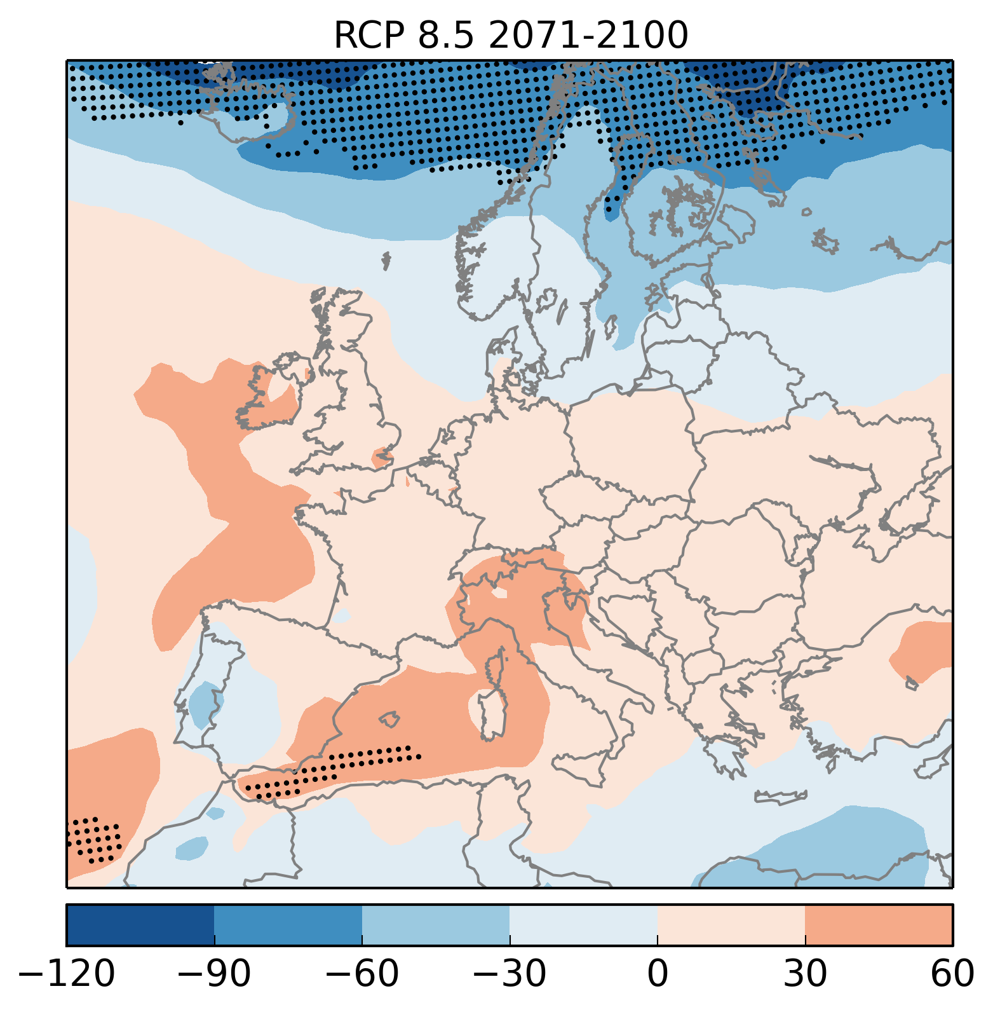
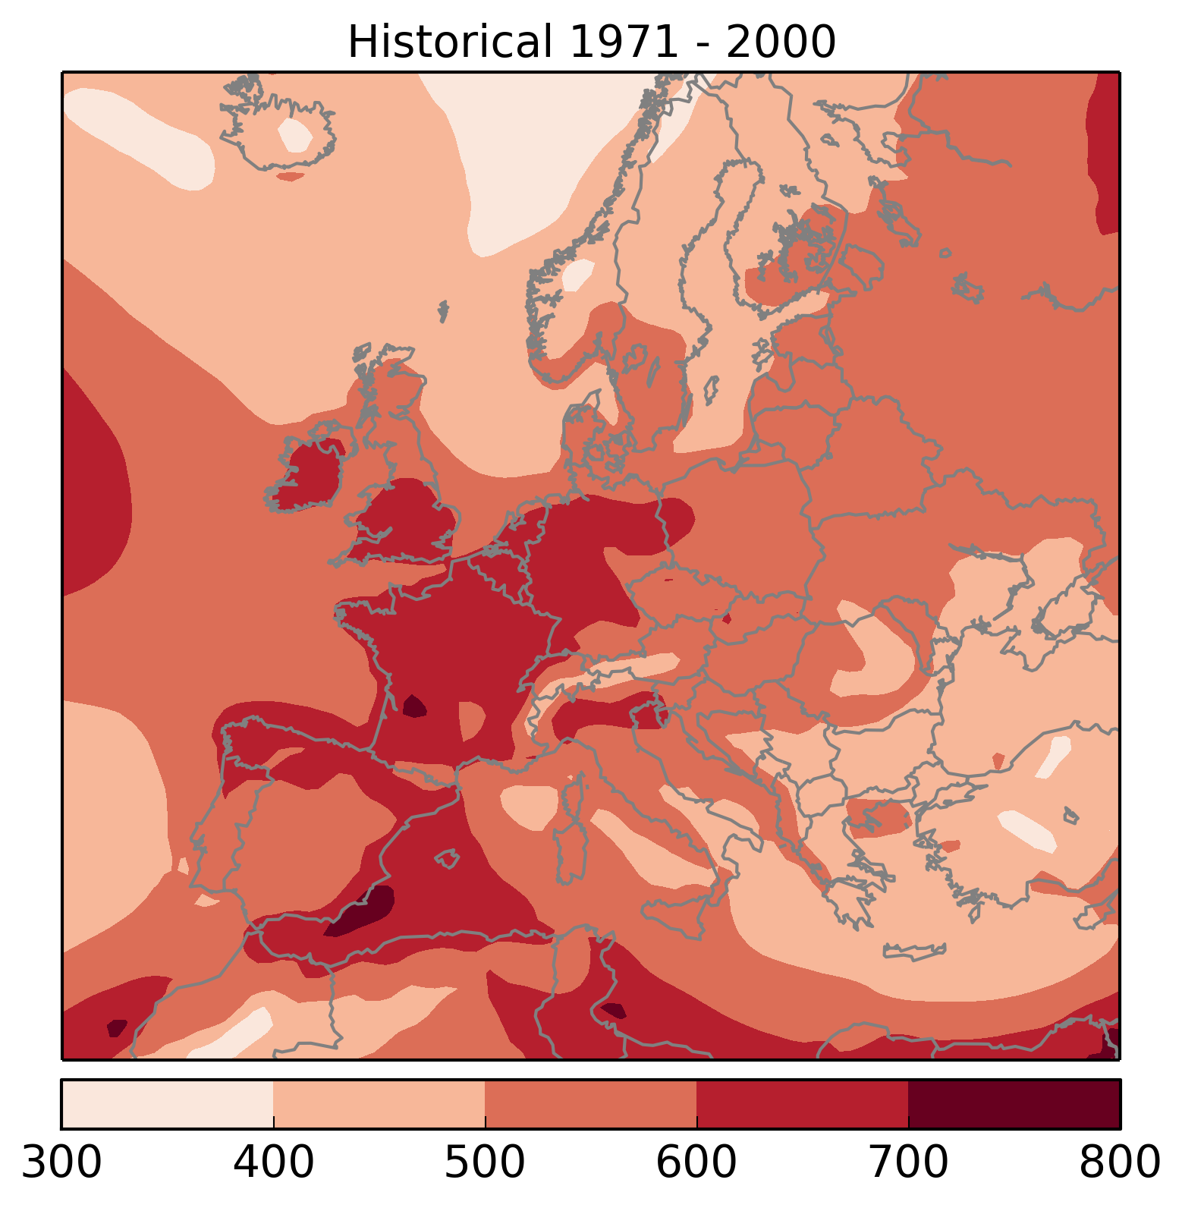
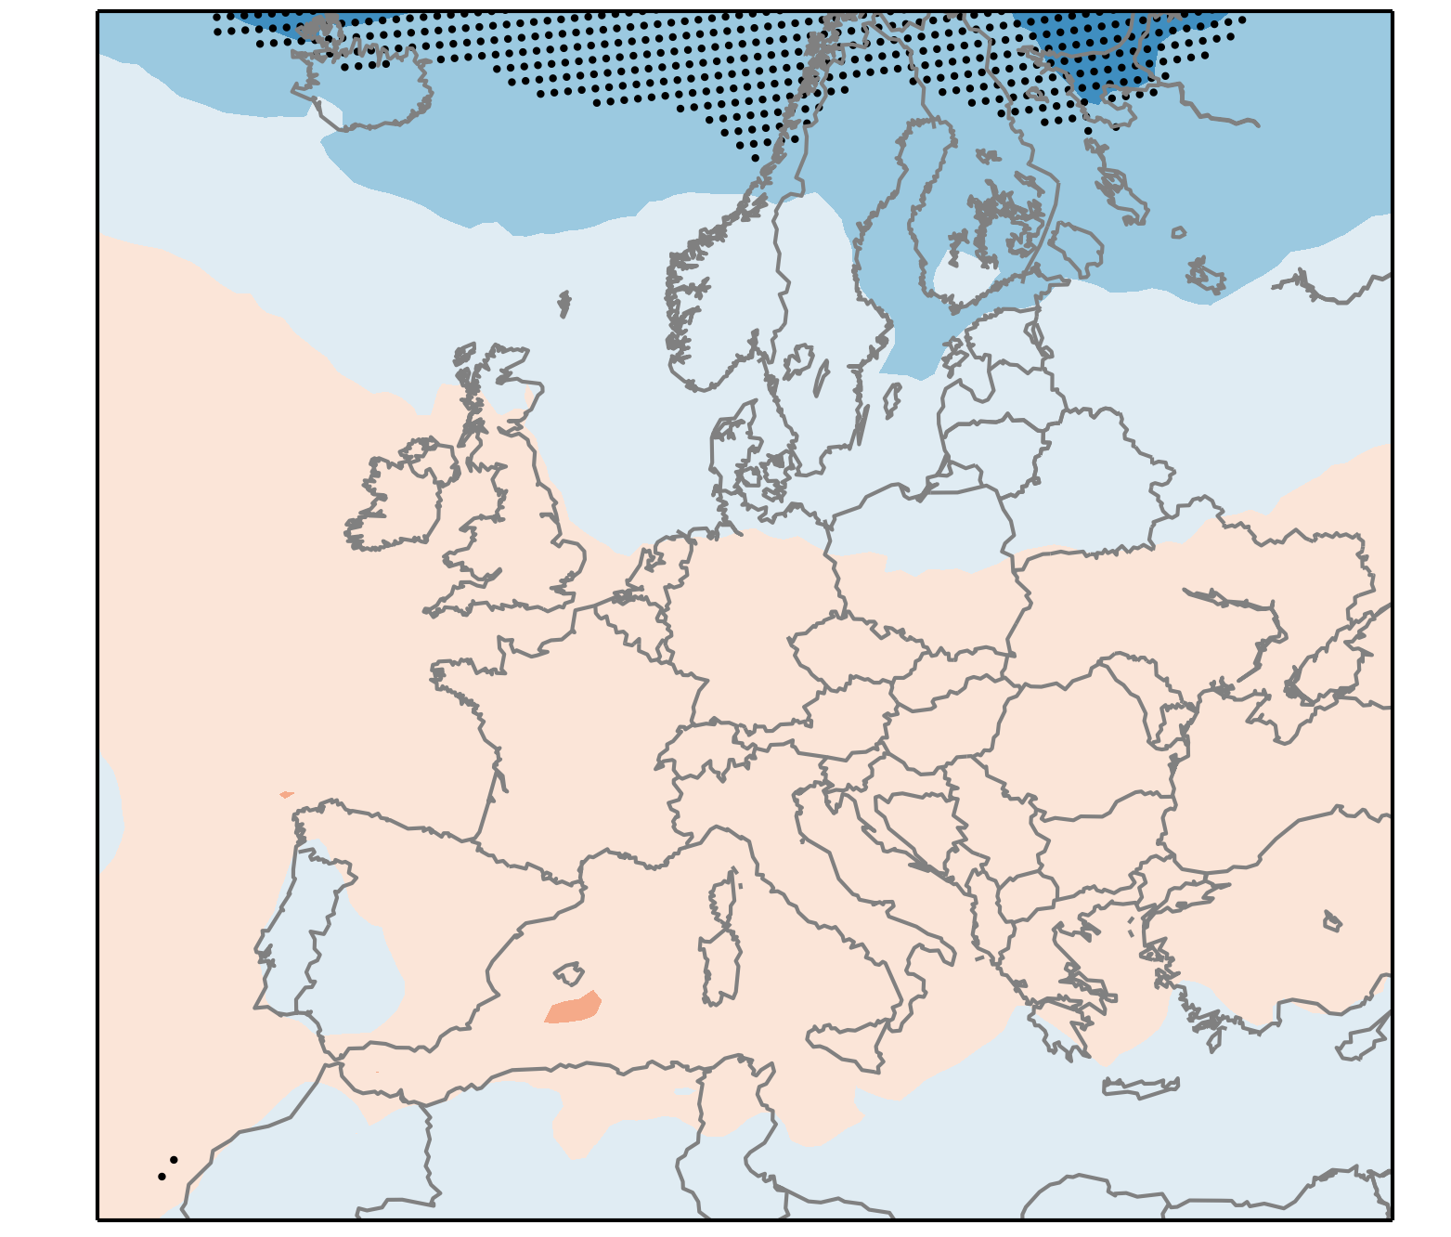
Shear
change until 2071-2100
robust decrease
RCP 8.5
severe environment:
unstable
strongly sheared
precipitating
DLS >= 15
not robust increase
1971-2000
RCP 4.5
similar pattern but smaller magnitude than RCP 8.5
annual number of 6-hourly periods

Slide 9
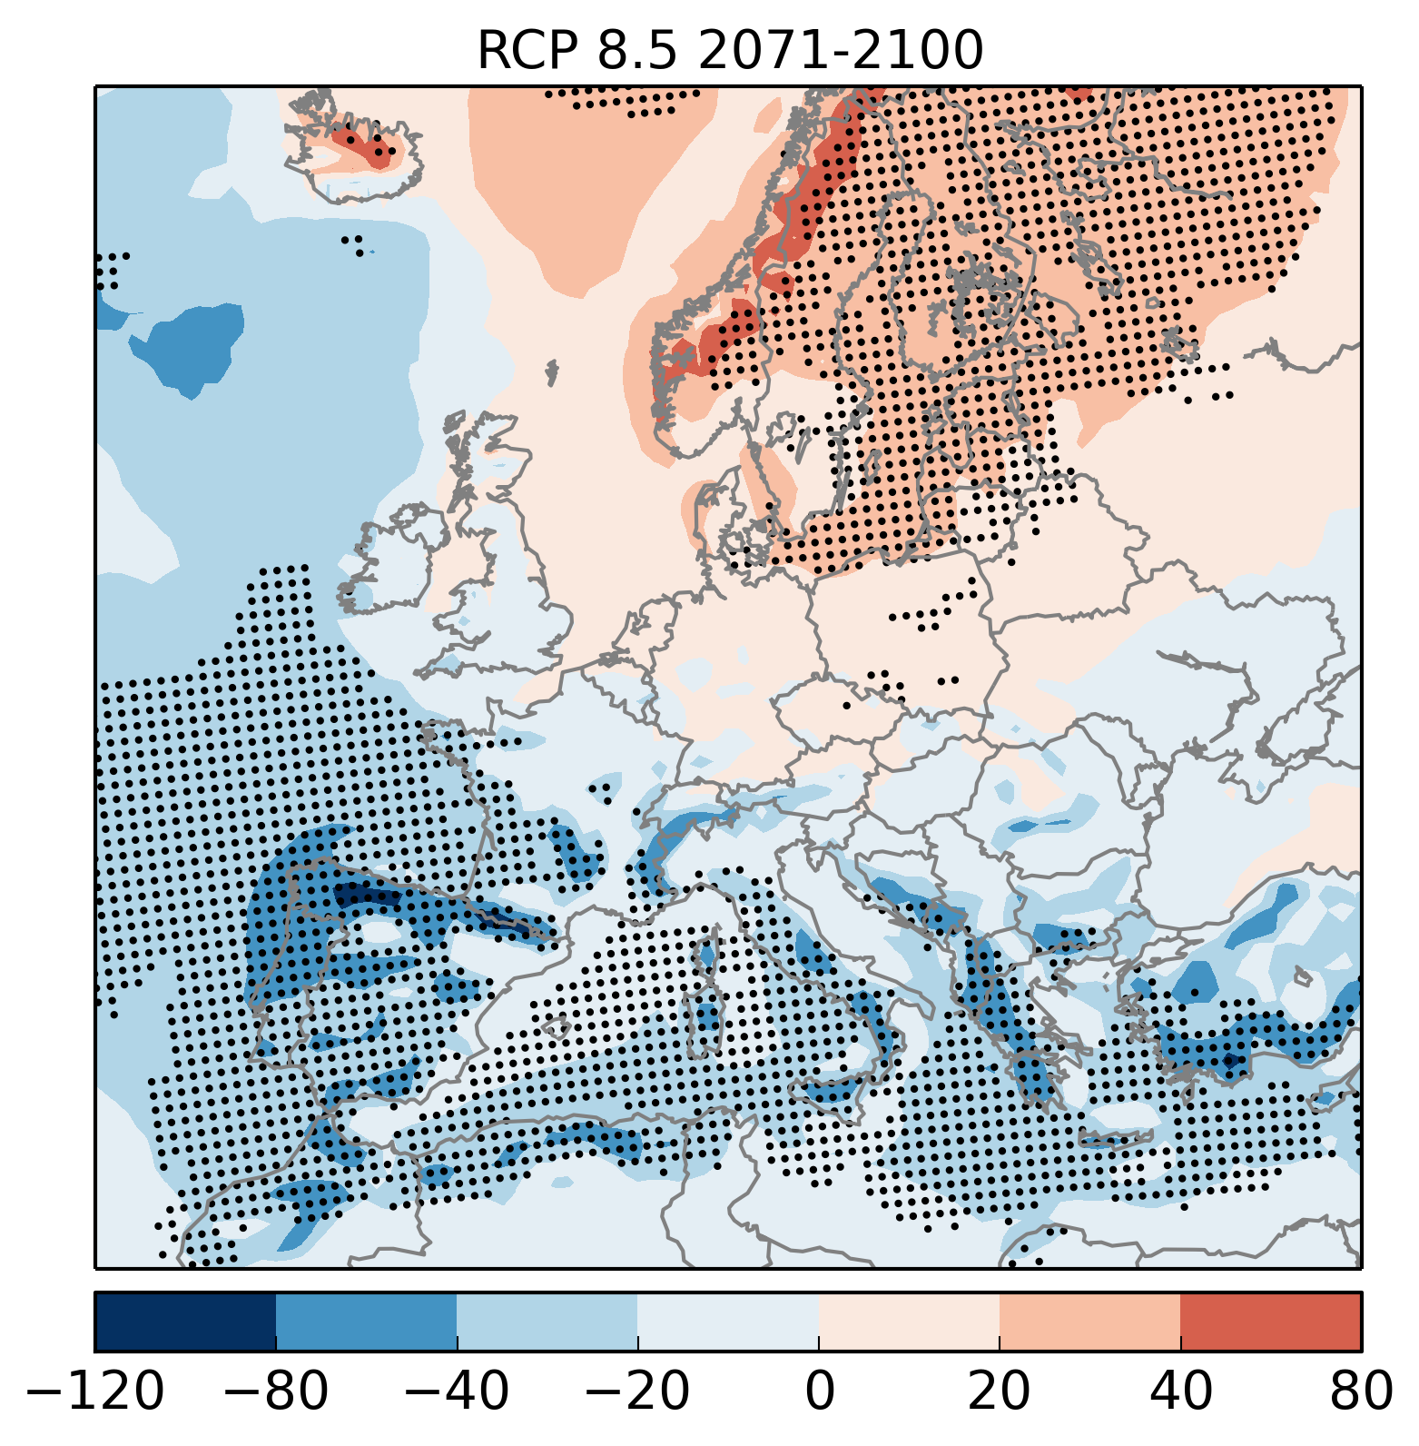
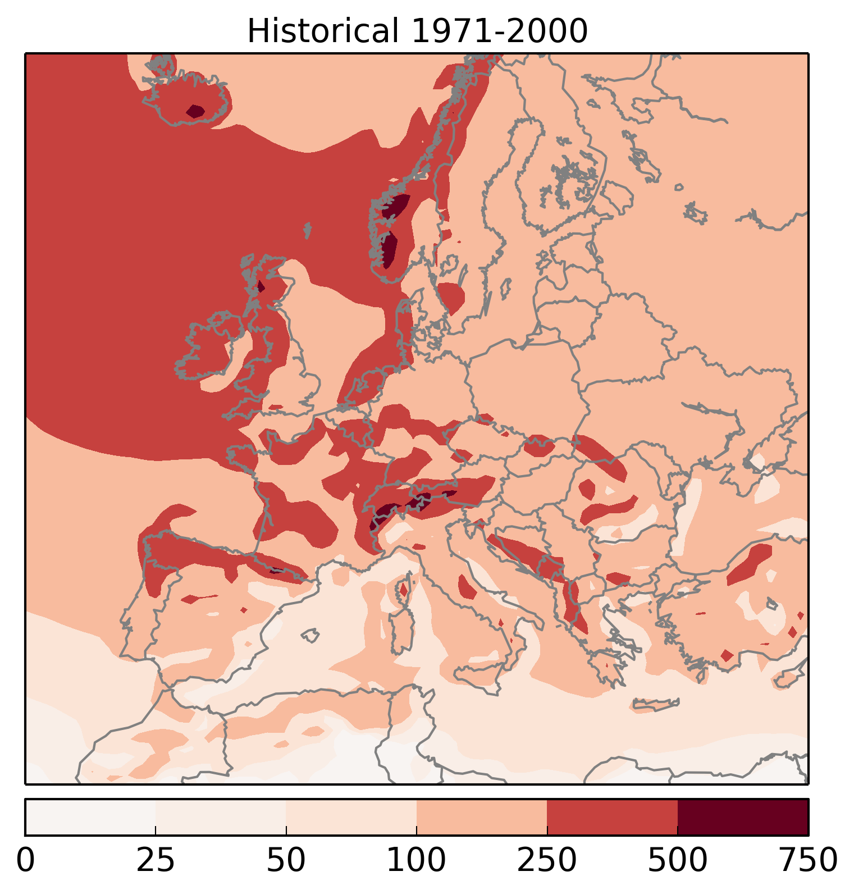
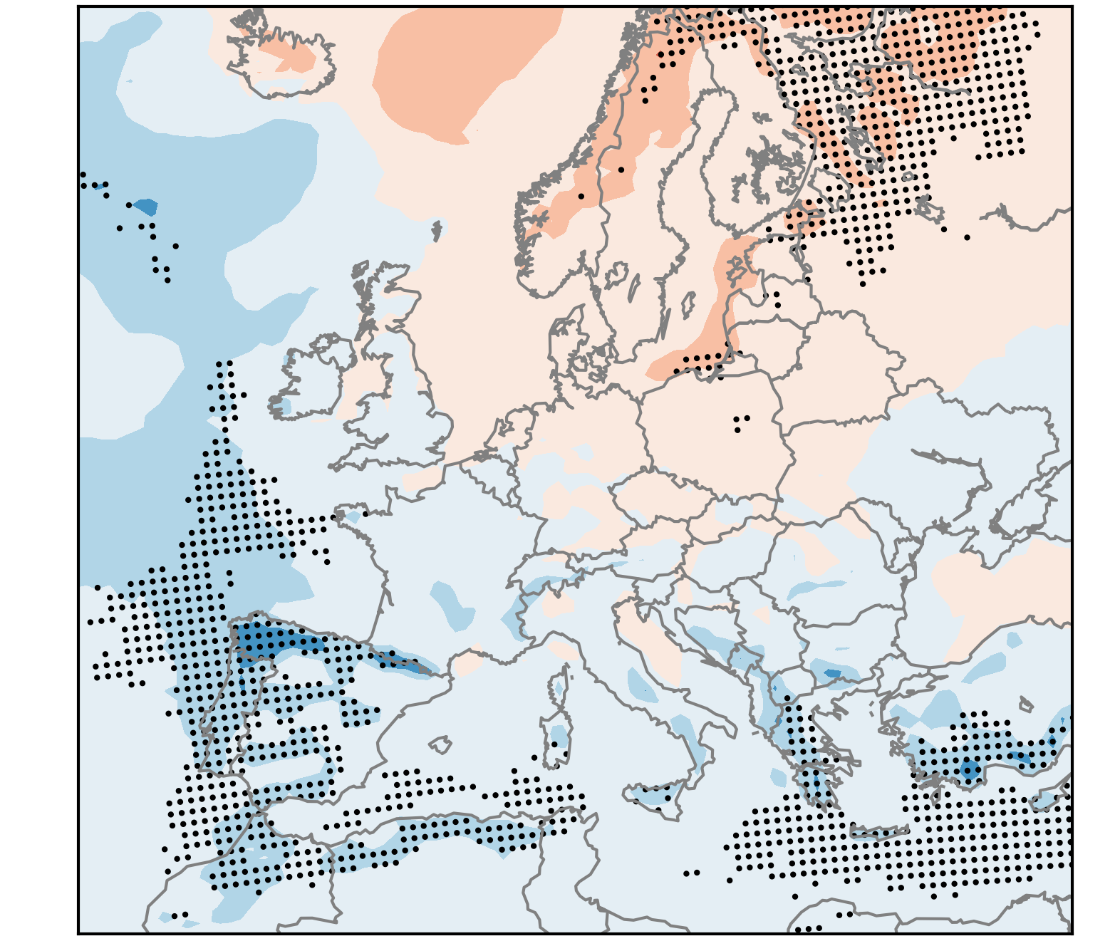
Precipitation
change until 2071-2100
robust increase
RCP 8.5
severe environment:
unstable
strongly sheared
precipitating
Precip >= 1
1971-2000
robust decrease
RCP 4.5
similar pattern but smaller magnitude than RCP 8.5
annual number of 6-hourly periods

Slide 10
Q1: Will the favourable environments for severe thunderstorms in Europe increase or decrease in the future? Why?
They are projected to increase especially over Central and Eastern Europe
Reason is the increase in instability
Over Southern Europe, drying is forecast, reducing the increase in severe thunderstorms

Slide 11
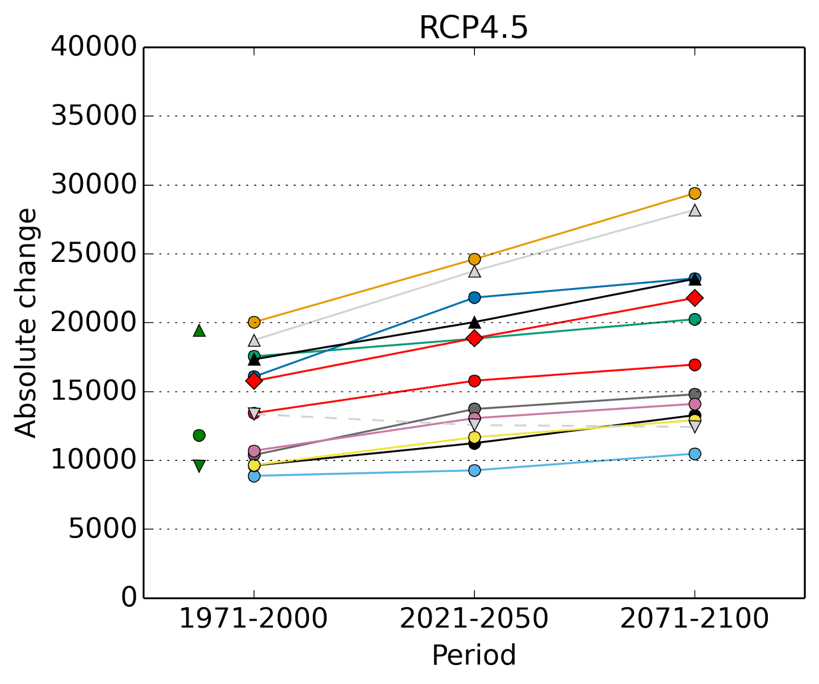
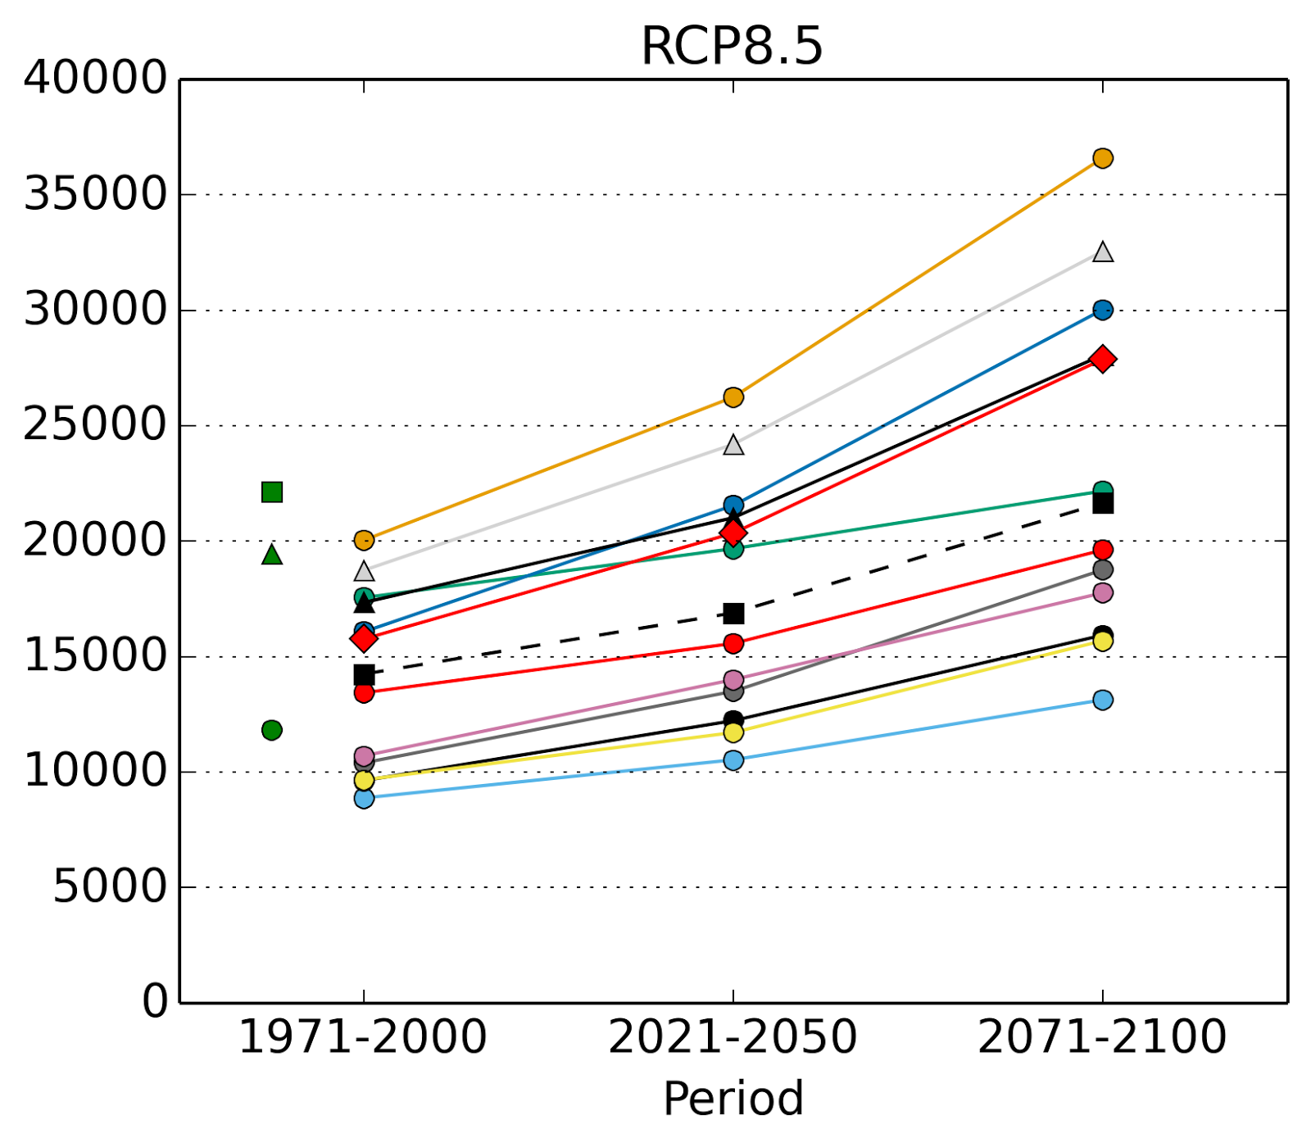
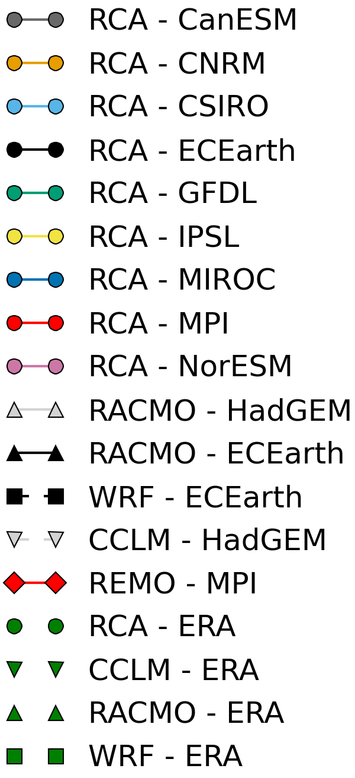
Q2: How big is the uncertainty in the models?
Mean annual number of severe environments in individual models
Models mostly agree on the direction of change
Large spread already for the historical period, increasing in the future
Source of spread (uncertainty): Instability

Slide 12
Limitations of results
Does not show the real number of severe thunderstorms and does not consider convective hazards separately
Poster by Anja T. Raedler et al. (no. 179) Thursday afternoon
„Additive Logistic Regression Models for Convective Hazards and their Application to Reanalyses and Climate Scenarios“
Inability of models to capture local maxima around the mountains (e.g. Alps)
Resolution: Usage of 0.11 ° resolution for limited domain

Slide 13
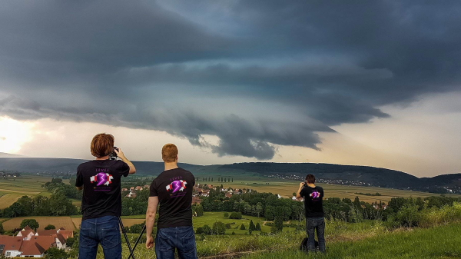
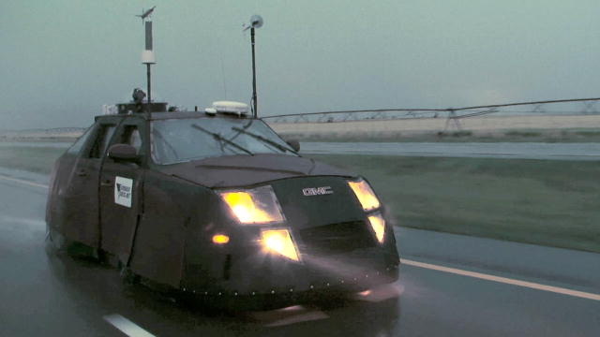
See you in 2099?
Any questions?
Contact me at
tomas.pucik@essl.org
Ensemble mean change in the severe environments
by 2071 – 2100 in the RCP 8.5 scenario
?
Image sources: discovery.com and facebook.com/level3stormchasers

Slide 14
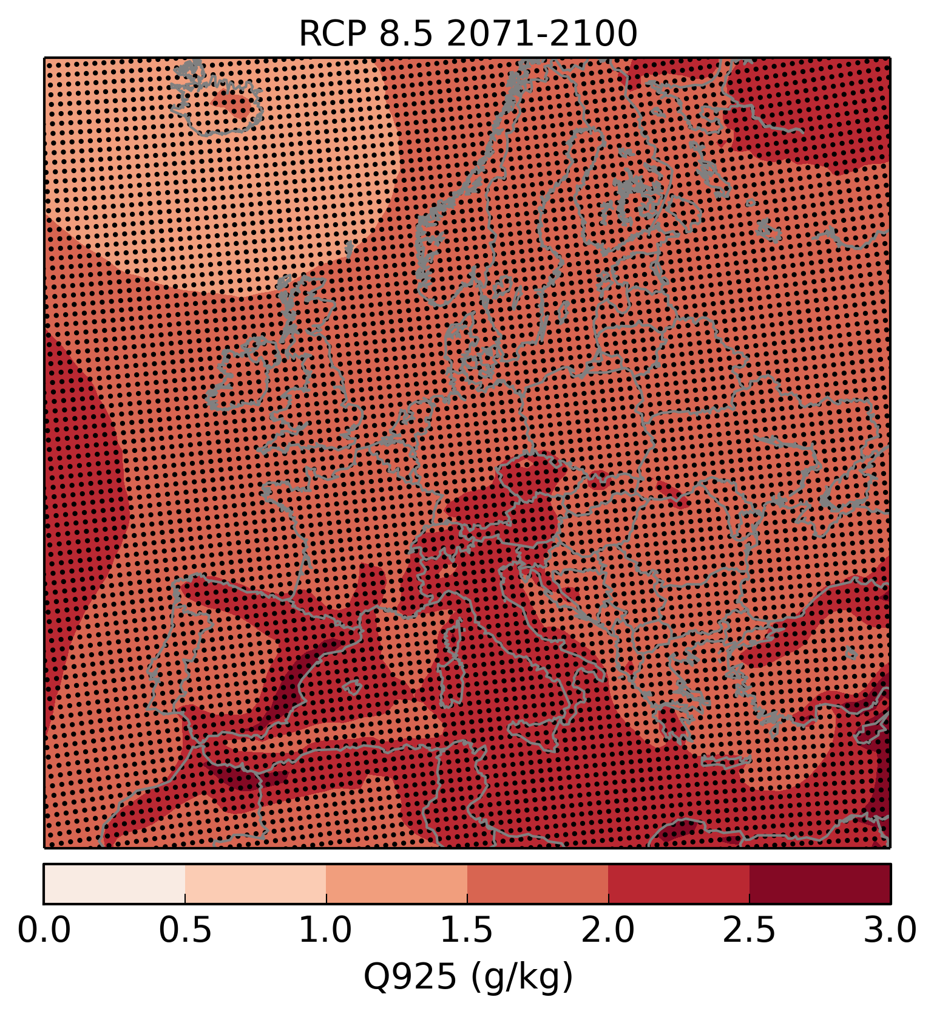
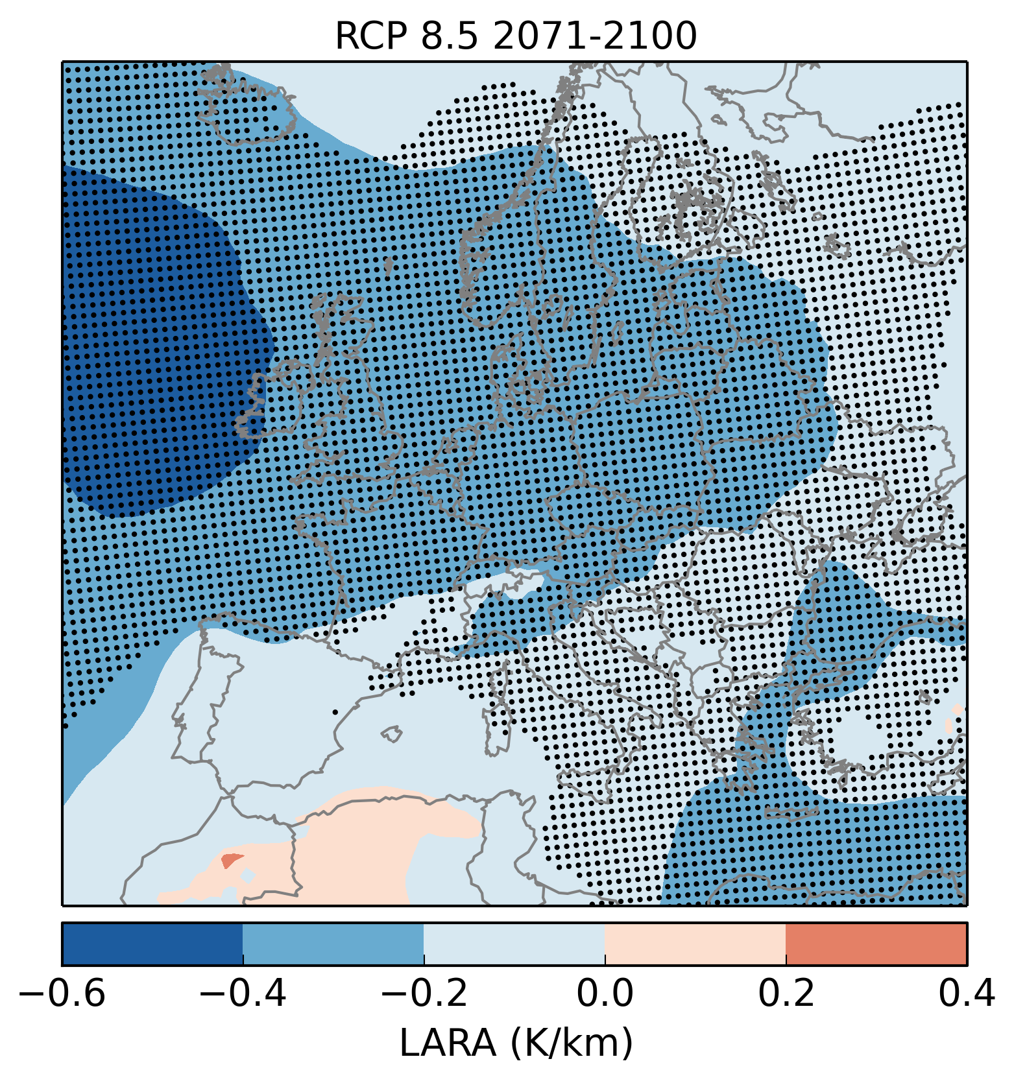
Moisture vs lapse rates
90th percentile
925 hPa mixing ratio
90th percentile
850 – 500 hPa lapse rates
Robust
increase
mostly
Robust
decrease
mostly

Slide 15
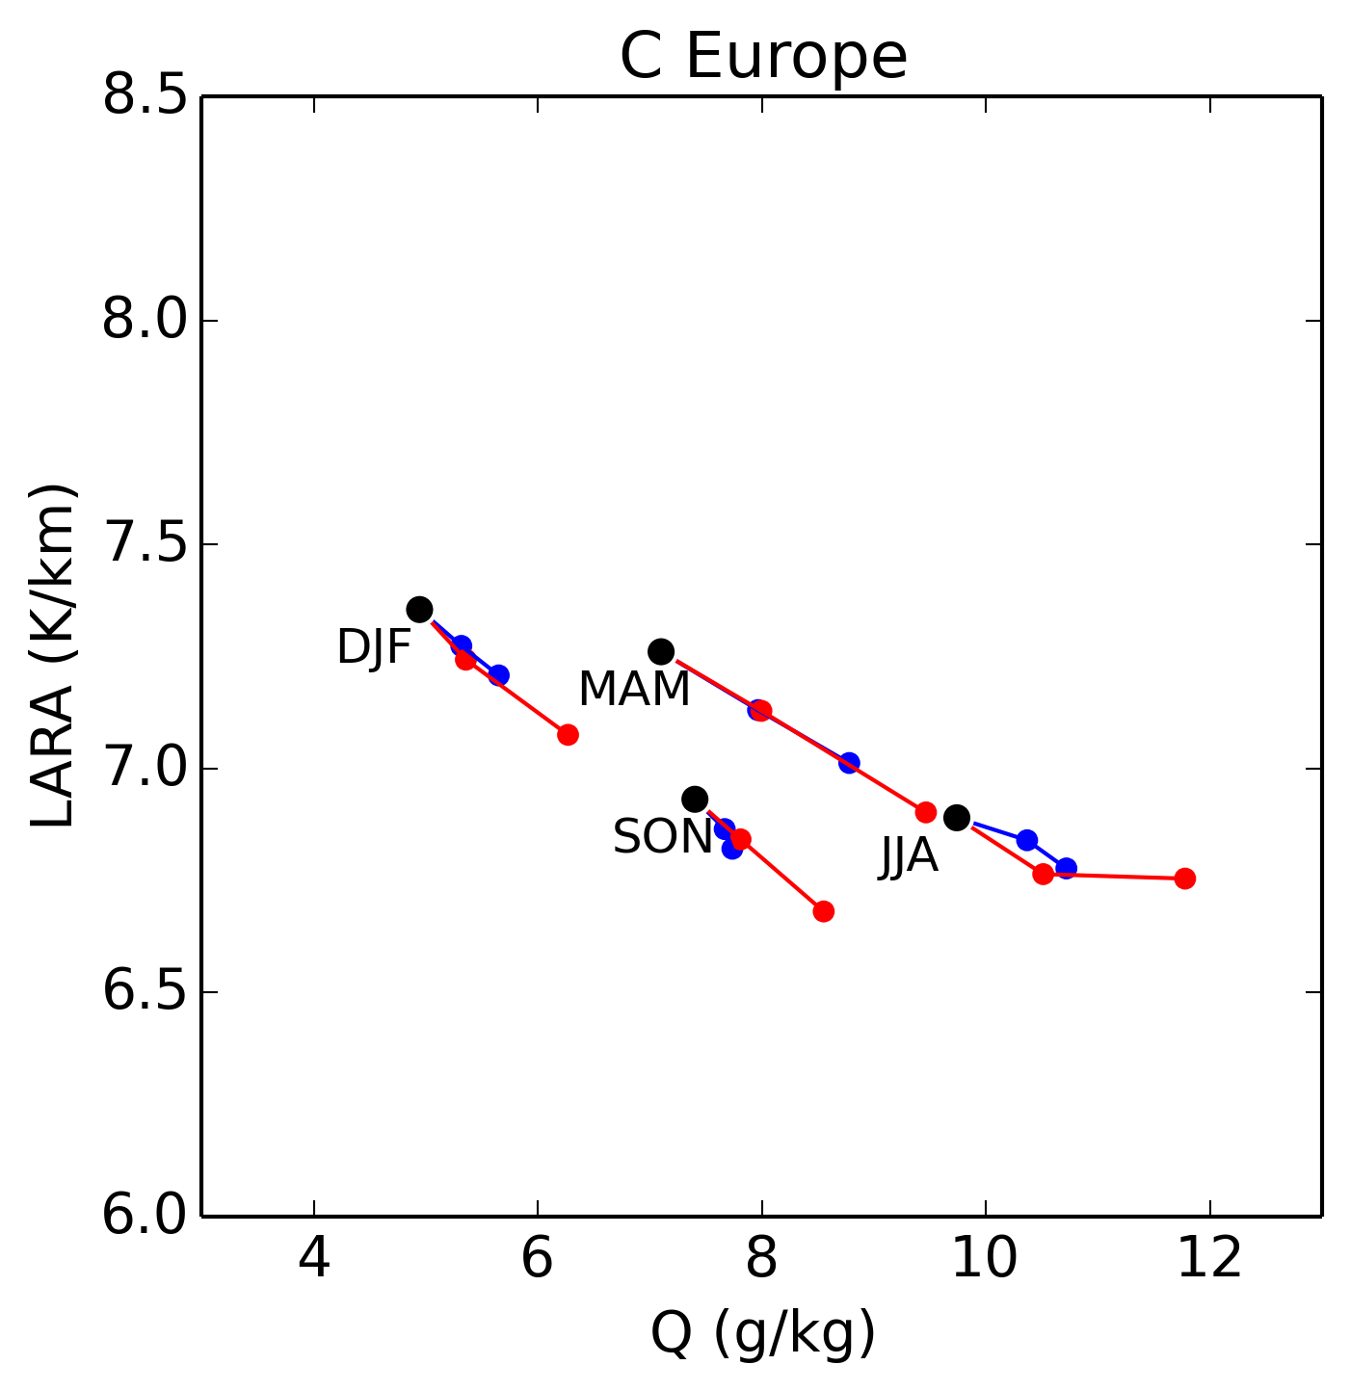
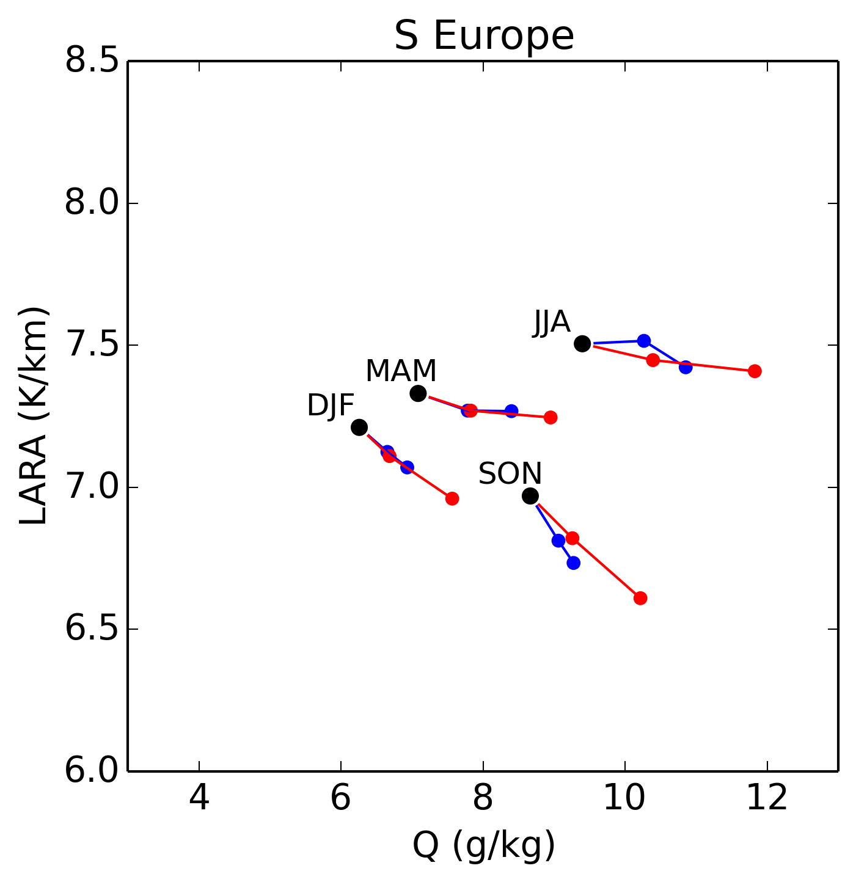
Seasons LARA vs Q925

Slide 16
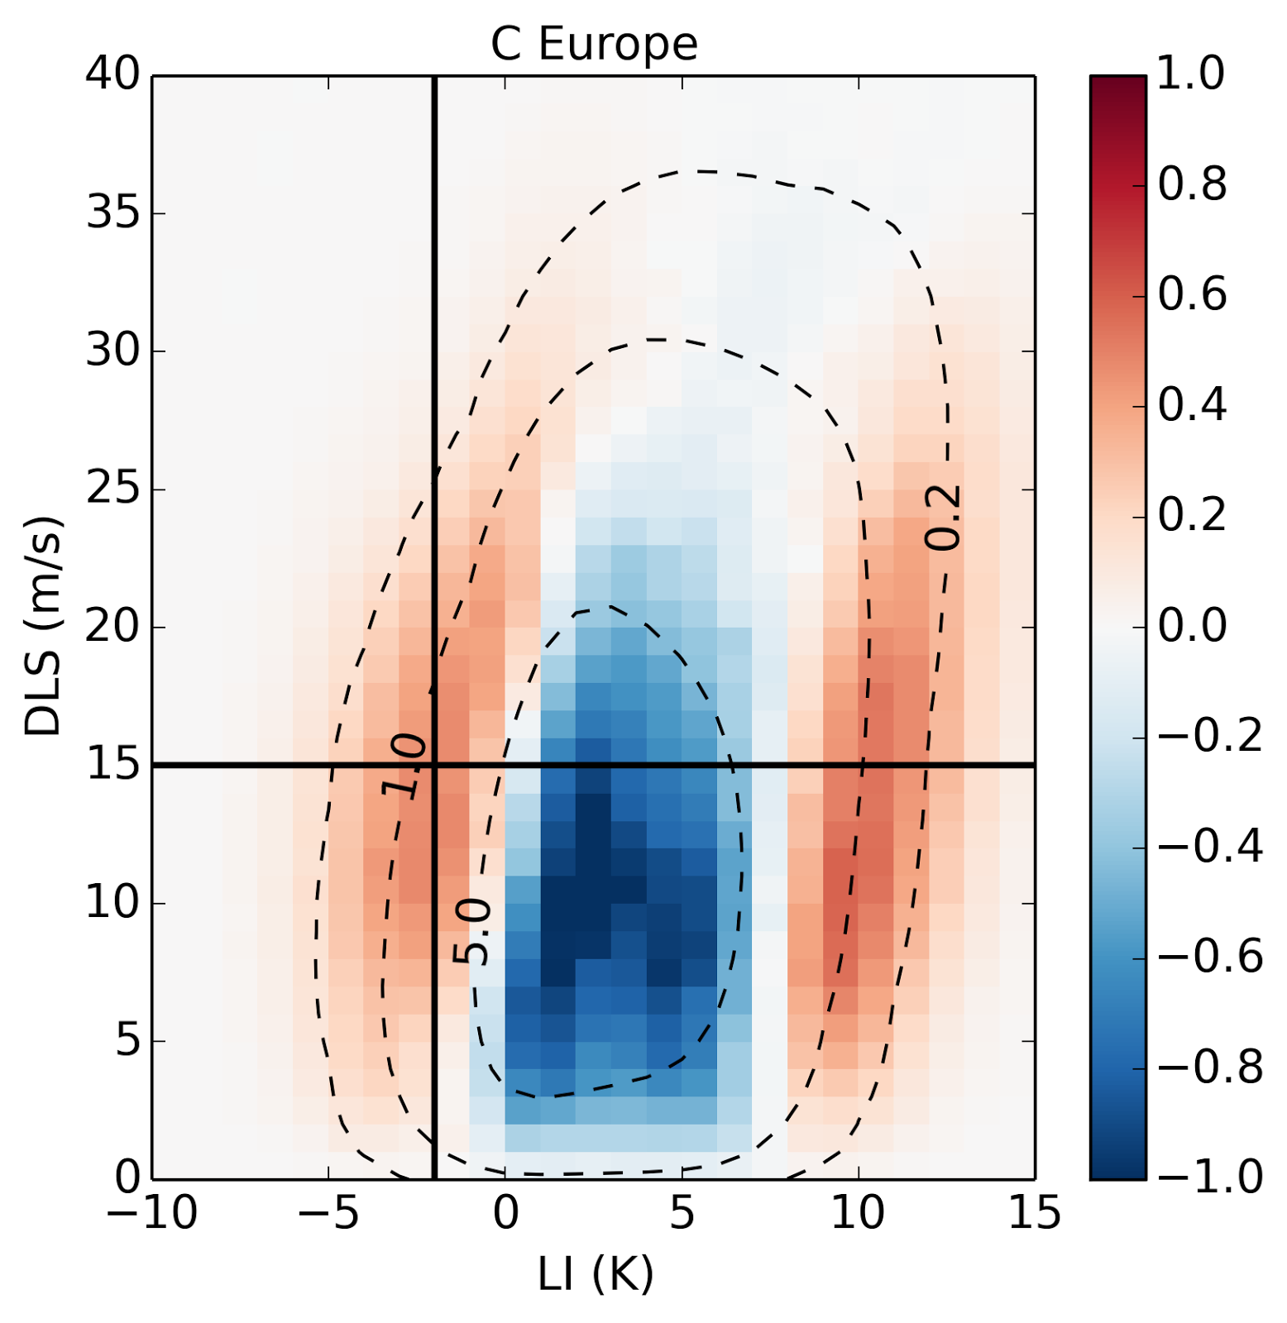
Changes in LI and DLS parameter space
Annual mean number of environments in
1 K and 1 m/s grid
Increase in unstable environments
regardless of vertical wind shear
Increase in extremely stable
environments
Decrease in weakly stable
environments

Slide 17
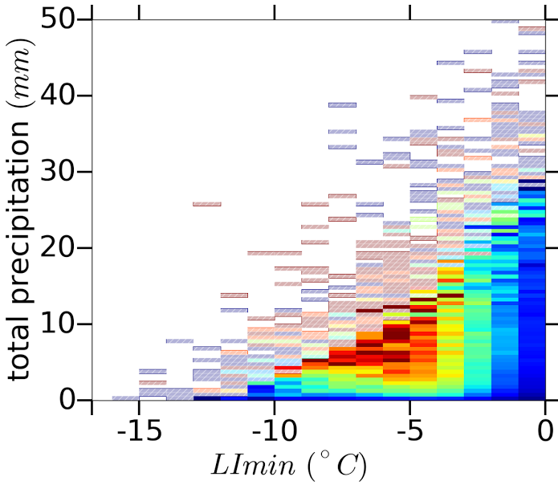
Precipitation vs LI model

Slide 18
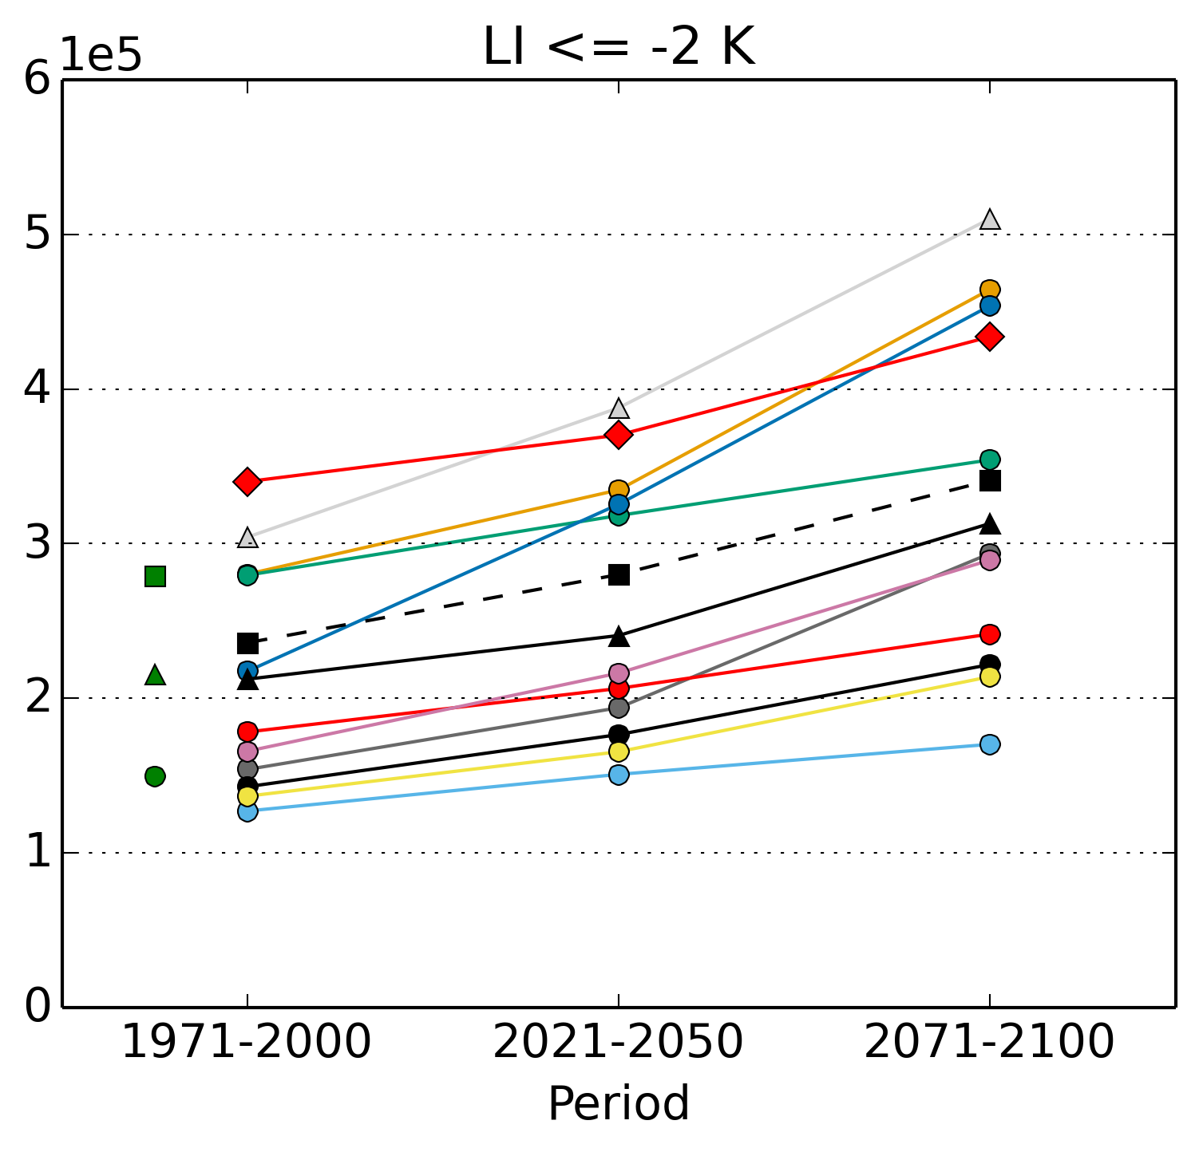
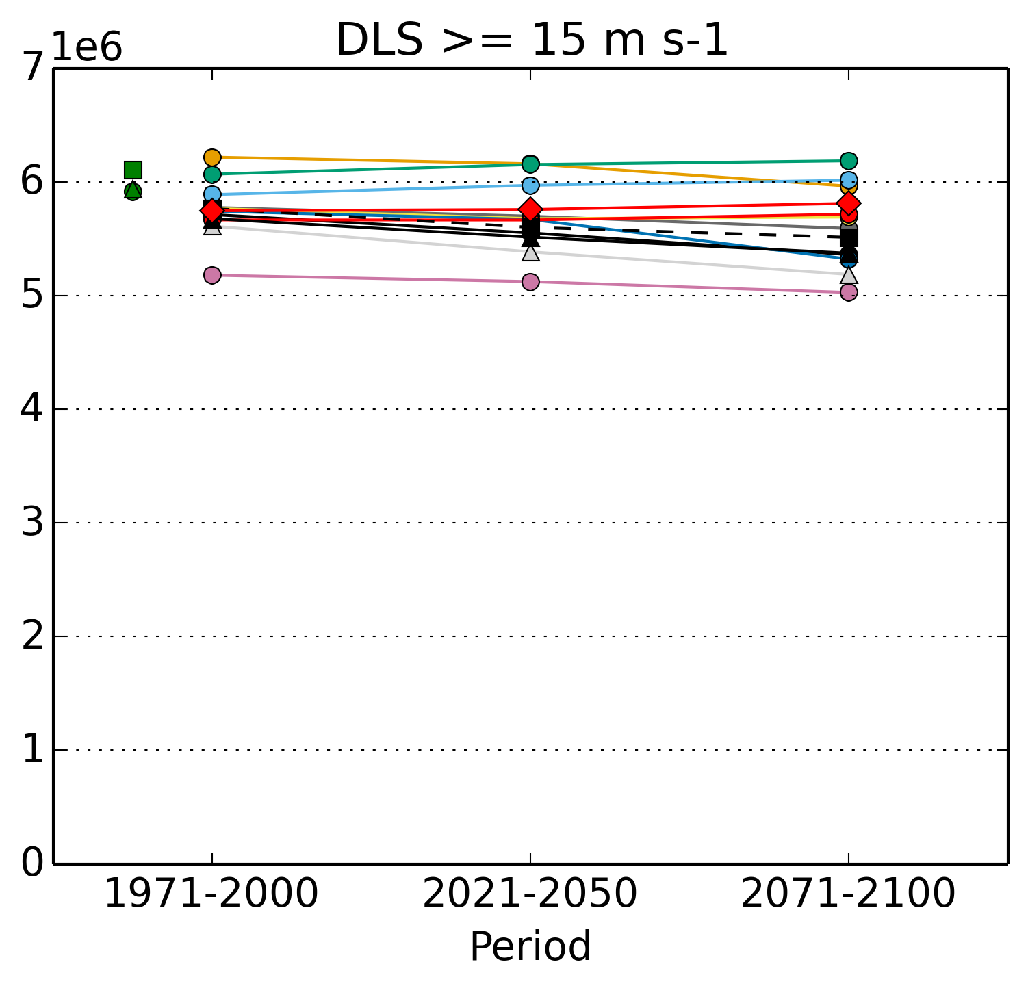
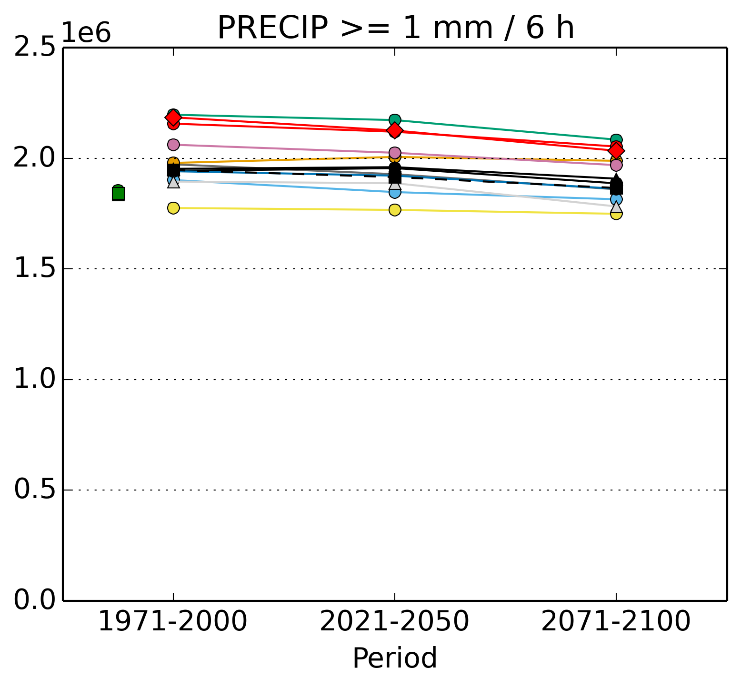
Model spread individual parameters

