Slide 1
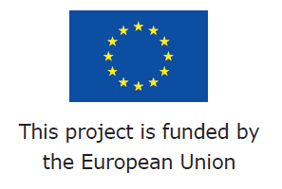
20th International Scientific Conference
CRISIS SITUATION SOLVING IN SPECIFIC ENVIRONMENT 2015
Zdenek Dvorak
Zilina 20th May 2015 web source: http://fbi.uniza.sk/kkm/stranka/aktualna-konferencia

Slide 2

Case study WP3 - Impacts of river floods on road and rail critical infrastructure in North - West Slovakia
SCSin SE
Zilina
20-21 May 2015
Zdeněk Dvořák
University of Žilina zdenek.dvorak@fbi.uniza.sk
www.rain-project.eu

Slide 3
Task 3.1: Identify and Review of Critical Land Transport Infrastructures failure (Case Studies – NW Slovakia)
Describing specific case studies having destruction impacts on critical transport infrastructure.
UNIZA will solve the impacts of river floods on road and rail critical infrastructure in North- West Slovakia (UNIZA Region)
D 3.3 Scenarios and case study of river floods on road and rail critical land transport infrastructures (M12)

Slide 4
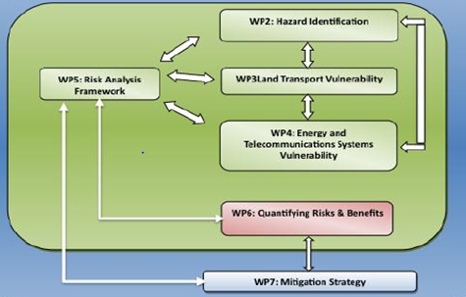
Task 3.1: Place and connection of case studies in RAIN

Slide 5
Task 3.1: Participation on case study - NW Slovakia
Alan O Connor, Brian Caulfield, Maria Nogal (TCD)
Pieter Groenemeijer, Tomáš Púčik (ESSL)
Timo Hellenberg (HI)
Chiara Bianchizza (ISIG)
Mária Lusková, Zdeněk Dvořák, Zdeněk Jadrný, Bohuš Leitner (UNIZA)
and Slovak partners:
Ľubomír Hollý (Regional department Zilina)
Karol Chorváth, Tibot Šiiška (Ministry of transport SR)

Slide 6
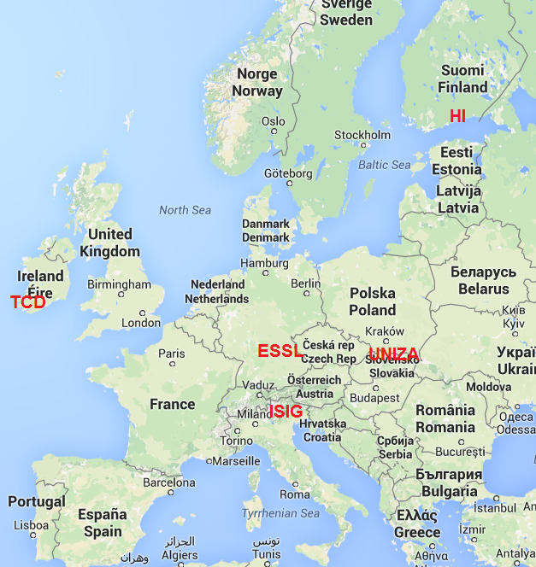

Slide 7
Task 3.1: Methodology of case study - NW Slovakia
Study relevant international projects and books - all
Creating recommended content – TCD, ISIG, HI, UNIZA
Developing methodology – TCD, ISIG, HI, UNIZA,
Analyzing contemporary statue – UNIZA, Slovak partners
Analyzing weather events in past – ESSL, UNIZA
Recommendations and conclusions – UNIZA, Slovak partners

Slide 8
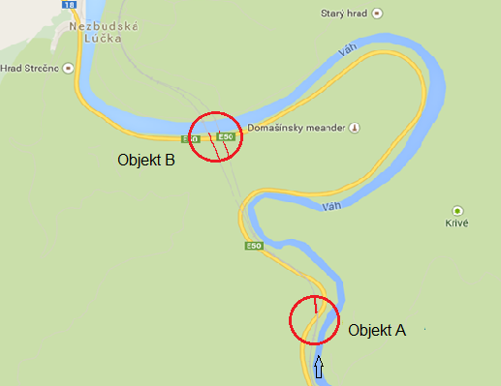
Task 3.1: Structure of case study - NW Slovakia
Executive Summary
Introduction
Shortcuts and key terms
Analyses of contemporary statue
Analyses phase after the event – scenario
Conclusion
References
Appendix I
Chosen objects

Slide 9
Ad 2. Case study - Introduction
the background to the issue,
the objective or purpose of the report,
a definition of the research problem/topic,
a definition of the report’s terms of reference),
an outline of the report’s structure,
an overview of the report’s sections and their relationship to the research problem,
an outline and justification of the scope of the report ,
a description of the range of sources used,
acknowledgment of any valuable assistance received in the preparation of the report

Slide 10
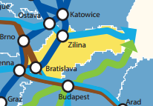
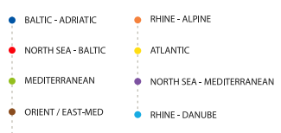
Ad 3. Case study - Shortcuts and key terms
Key words:
Critical infrastructure,
Critical infrastructure element,
Critical infrastructure sector,
Sectoral criteria,
Cross-cutting criteria,

Slide 11
Ad 4. Case study - Analyses of contemporary statue
4.1 General framework for civil protection
System of civil protection and crisis management is base on law 42/1994 revised 2014.
Training of local and regional civil protection bodies
International cooperation
4.2 Historical, societal and legal aspects of the civil protection system
Changes between civil protection before 1989 and after 1989

Slide 12
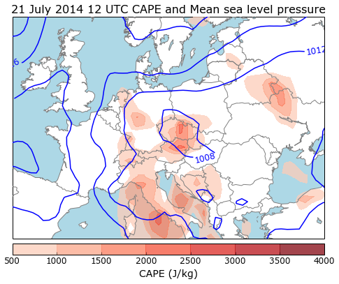
Ad 4. Case study - Analyses of contemporary statue
4.3 Description of meteorological event - ESSL
Heavy Rainfall
Windstorms
Coastal Floods
River Floods
Landslides
Lightning
Tornadoes
Hail
Convective Windstorms
Snowfall and Snow Storms
Icing Snow Loading
Forest Fires
Freezing rain

Slide 13
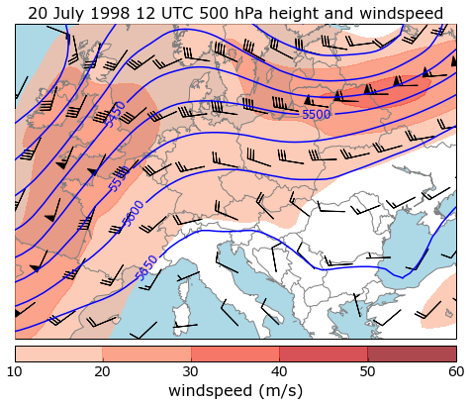
Ad 4. Case study - Analyses of contemporary statue
4.3 Description of meteorological event - ESSL
Analyze of real historical meteorological events
Event analysis
Lack of high-resolution satellite and radar data from this case preclude any detailed analysis of the thunderstorm development and progression (Sokol and Sokolova, personal communication). However, it seems that thunderstorm existed in a form of a slowly moving multicellular system with signs of backbuilding (i.e. new thunderstorm cells forming against the direction of prevailing flow). Analysis of Slovak Hydrometeorologic Institute (1998) also mentions the supercellular nature of the thunderstorm, which could be supported by the fact that besides the flash flood, also very large hail was observed by the local inhabitants (hen egg size).

Slide 14
Ad 4. Case study - Analyses of contemporary statue
4.4 Description of transport infrastructure before the event
Multimodal corridors
Trans - European Transport Network (TEN-T)
4.4.1 Railway infrastructure – function and capacity
Bridgdes and tunnels
4.4.2 Road infrastructure – function and capacity
Bridges and tunnels
4.4.3 Summary for road and rail transport
Advantages and challenges
4.5. Description of management – phase planning
System of crisis planning

Slide 15
Ad 5. Case study - Analyses phase after the event – scenarion
5.1 Description of meteorological event - heavy rainfall and dam defect creating hypothetic extraordinary flood
  5.2 Description of transport infrastructure after the event - flooding of rail and road network
  5.2.1 Function/capacity - influence for region
  5.2.2 Structural elements - municipality and recovery units
  5.3 Description of management – detailed description
  5.4 Damage caused to people travelling on the transport route during the event
  5.5 Management of emergency – integrated emergency system
  5.6 Recovery – road and rail companies, building companies and inhabitants

Slide 16
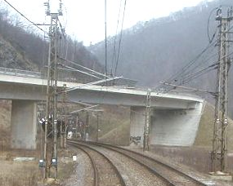
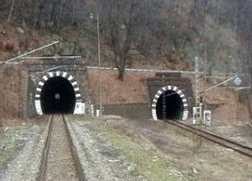
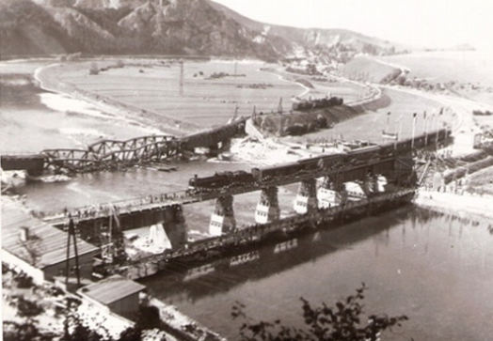
Ad 5. Case study - scenario – rail transport

Slide 17
Ad 5. Case study - scenario – rail transport

Slide 18
Ad 5. Case study - scenario – rail transport

Slide 19
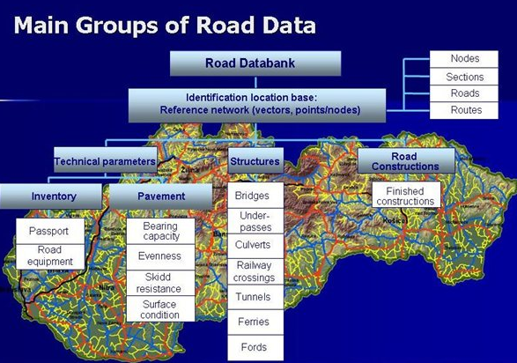
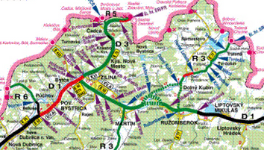
Ad 5. Case study - scenario – road transport

Slide 20
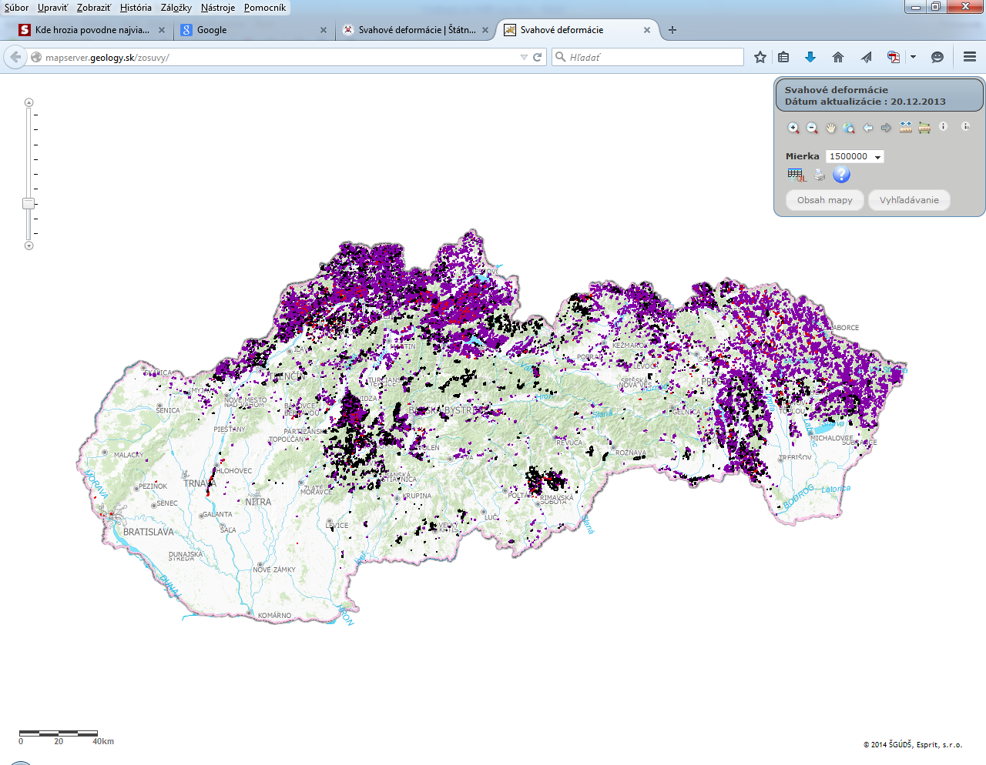
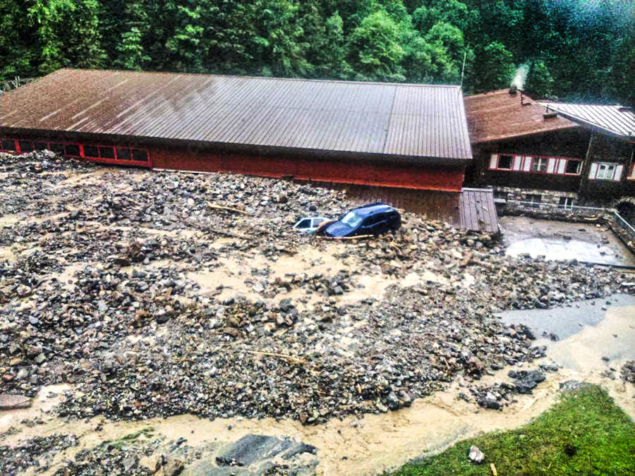
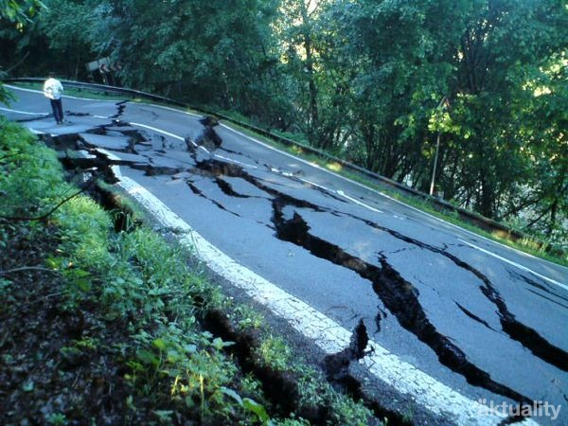
Ad 5. Case study - scenario – landslides

Slide 21
Ad 5. Case study - scenario – landslides

Slide 22
Ad 5. Case study - scenario – landslides

Slide 23
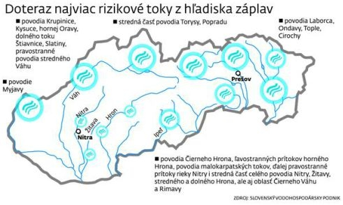
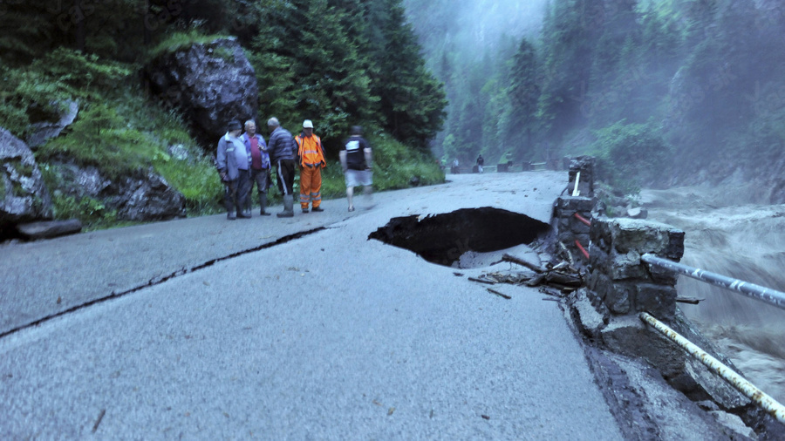
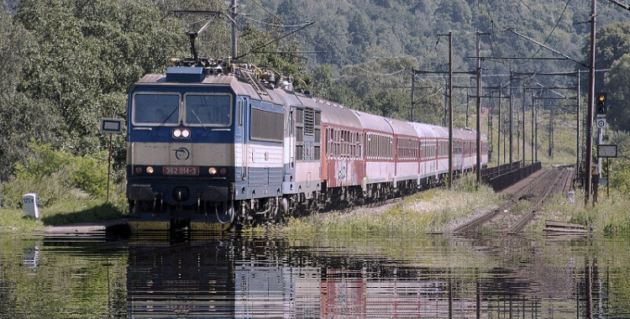
Ad 5. Case study - scenario – river floods

Slide 24
Ad 5. Case study - scenario – river floods

Slide 25
Ad 5. Case study - scenario – river floods

Slide 26
Conclusion
Recommendations and conclusions:
New and better infrastructure
Better communications between transport companies and municipalities
Actual crisis plans
Preparing electronic risks maps
Preparing fully automatic information system
….

Slide 27
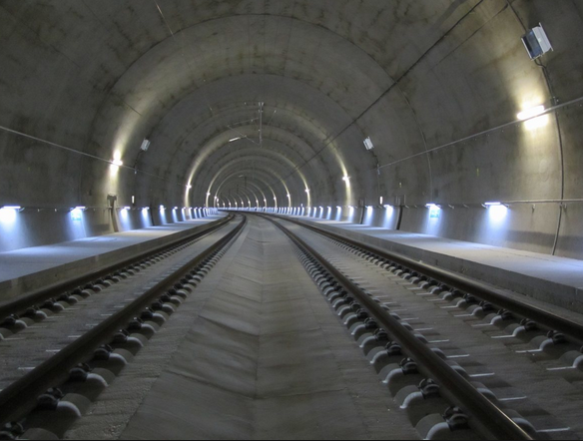
Conclusion – New and better infrastructure

Slide 28
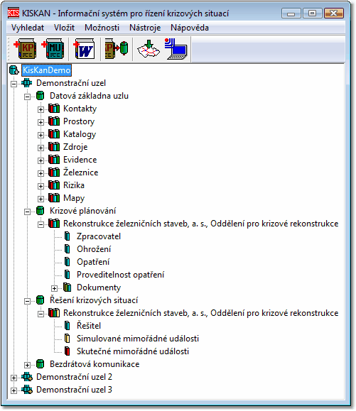
Conclusion – Actual crisis plans
Demonstration event
Database
Contacts
Spaces
Catalogue
Sources
Evidence
Railway
Risk
Maps
Crisis planning
Threats
Measures
Documents

Slide 29
Conclusion - fully automatic information system
KISKAN Mobile
Mobile source
Mobile source
Mobile source
No 1
No 2
No 3
Internet
IMAP Server
KISKAN
Database
SMTP Server
Email server
Server
KISKAN Server
Dispapching desk
KISKAN Windows

