Slide 1
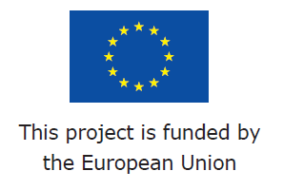
SE3/AM2: Severe weather impacts for the European society in the past, present and future Self assessment tools as means of informed decision-making for the mitigation of climate change impacts
16th EMS Annual Meeting
Trieste,
13 September 2016
Chiara Bianchizza
ISIG
bianchizza@isig.it
www.rain-project.eu

Slide 2
Integrated vulnerability assessment
Vulnerability of communities/systems to climate change is a multidimensional concept.
It implies
biophysical
meteorological
social
economic
cultural
institutional and
management variables
Thus, vulnerability calls for an integrated framework for its assessment.
The social components of vulnerability contribute to the definition of sensitivity and adapative capacity of a given community/system

Slide 3
SeAT
Within the ECOSTRESS DG ECHO Project (2013-2015), www.ecostress.eu, ISIG has developed a Self Assessment tool for local managers, to evaluate the vulnerability of their community in terms of sensitivity (pre-existing condition of the system) and adaptive capacity (capacity of the system to cope with stress).
SeAT – Self Assessment tool –is targeted to policy makers to help them structure the relevant information needed to assess their vulnerability to external stress;
It is meant as a tool for local administrators to support them in informed decision making.

Slide 4
RAIN project
Within RAIN project – Risk Analysis of Infrastrastructure Networks in response to extreme weather - http://rain-project.eu/ ISIG is bringing in this experience to build a tool (on a dedicated software) for specifically supporting:
Transport infrastructures managers
in an assessment of the status quo of their infrastructures and management system (vulnerability/resilience)
in order to intervene with specific mitigation strategies for specific meteorological events.

Slide 5
RAIN
RAIN tool is:
A further development of SeAT and of Objective Ranking Tool (ORT) devised by Peter Prak
is currently being tested on 3 pilot municipalities (Italy and the Netherlands)
Will be released at the end of project (April 2017)

Slide 6
How the assessment works
Data-gathering grid: users evaluate their local community (in terms of both sensitivity and adaptive capacity) for what concerns the following dimensions:
Social
Economic
Infrastructural
Institutional
These dimensions are composed of variables, extrapolated from relevant literature and then verified for relevance in the context of reference through a Delphi panel session.
Internal dimension variables shape sensitivity (they are related to static elements); external dimension variables shape adaptive capacity (dynamic components)

Slide 7
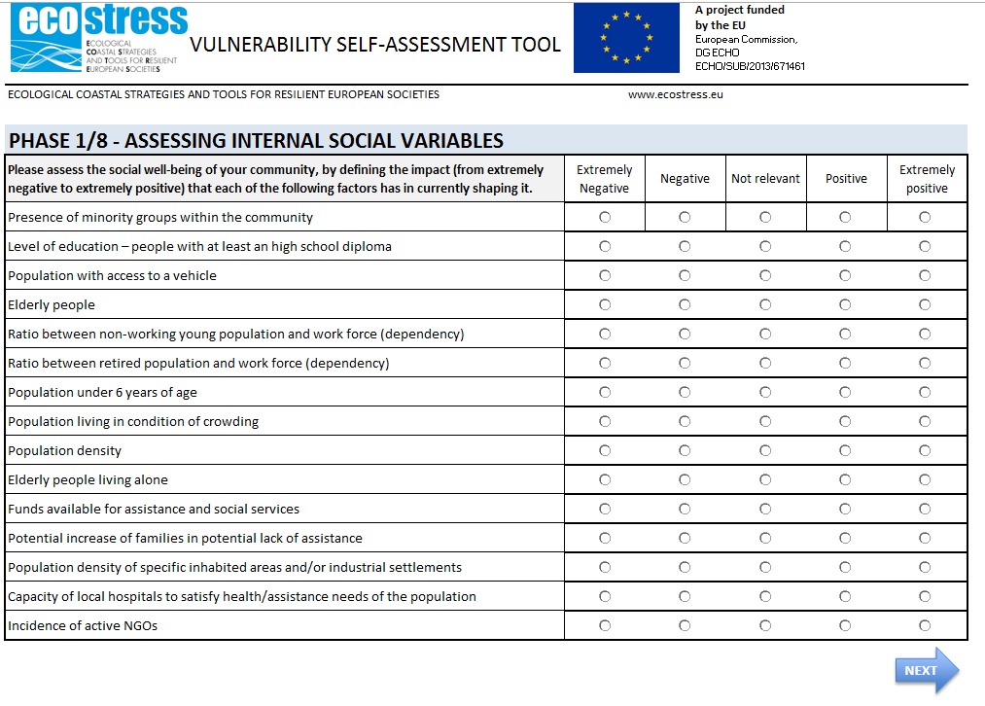

Slide 8
Once the last assessment grid is completed, users are redirected to the SUMMARY table, where factors previously selected as “Extremely Negative” or “Extremely Positive” are highlighted (in red and green respectively).
Selected factors will either appear as Weaknesses/Strength or Threats/Opportunities (in the left and right-hand columns respectively).

Slide 9
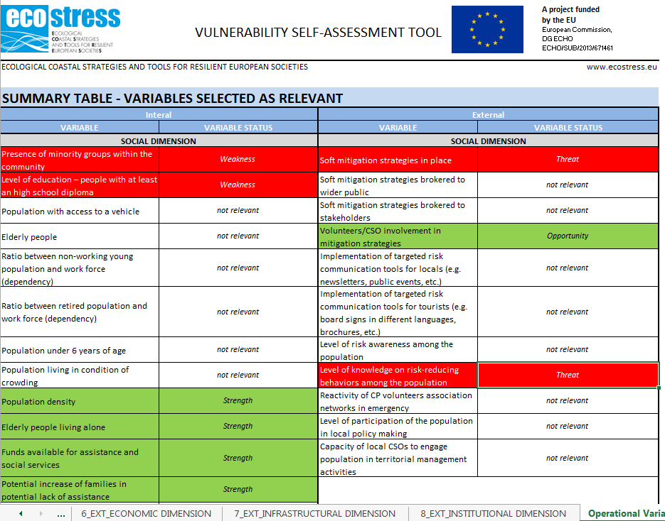

Slide 10
A graph is then produced by the tool, detailing the percentage of positive and negative internal and external elements characterizing the system.
Starting from here, users are re-directed to possible action strategies for their vulnerability-reducing or resilience-enhancement process.

Slide 11
A – policy makers can see how their area/community is set on a 0 to 10 scale (where 0 represents a total social vulnerability scenario and 10 a totally resilient 1)
A
B – policy makers can see the interaction among (relevant) positive and negative factors both at the sensitivity (internal) and adaptive capacity level
B
C
C – proceed to re-assessment

Slide 12
SeAT
SeAT – Self Assessment tool – is available online at:
http://ecostress.eu/social-vulnerability-self-assessment-tool/
Its video tutorial is available at:
https://youtu.be/_YD8aHxUdp4

Slide 13
THANK YOU FOR YOU ATTENTION
QUESTIONS?

